Slide 1
Notes:
Contents are getting richer, and more complex, and this is because of the user experience/content demand
More quality on movies, streaming (4k, 8k)
Online Gaming adoption is also growing
Internet usage grows every day; Everyone is adopting new technologies
Digital Transformation
Digital Modernization (hospitals, lawyer firms, etc.)
5G and IoT

Slide 2
Hyperscale
Security
Carlos Martins | Check Point Portugal
31.05.2023

Slide 3
Agenda
Unique, Adaptable & More Scalable Security solution in the industry

Slide 4
TRENDS
DC traffic demand
Traffic DOUBLES Every 3 years
Our Networks Grow up to
25%
Year Over Year

Slide 5
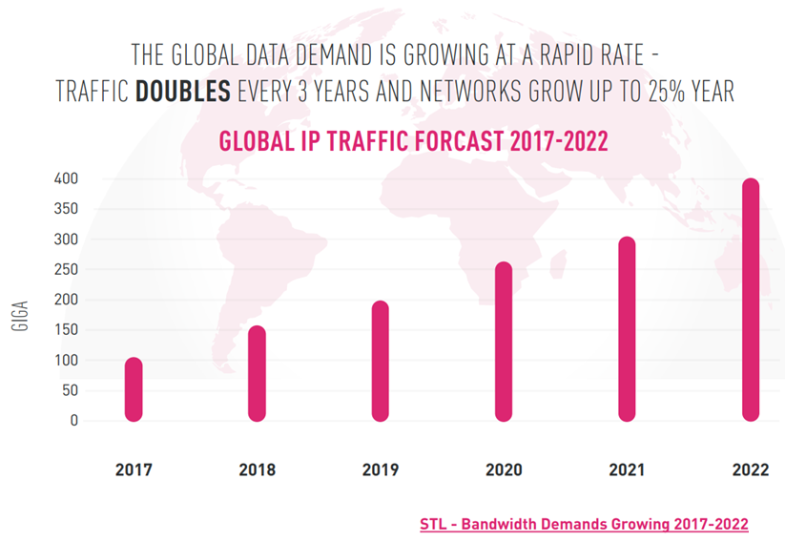
Demand for growth (trend)
Notes:
Internet usage grows every day; Everyone is adopting new technologies (parents example)
Kids just use online streaming (Netflix, Youtube, Disney+
Contents are getting richer, and more complex, and this is because of the user experience/content demand
More quality on movies, streaming (4k, 8k)
Online Gaming adoption is also growing without precedent
Digital Transformation
Digital Modernization (hospitals, lawyer firms, etc.)
5G and IoT

Slide 6
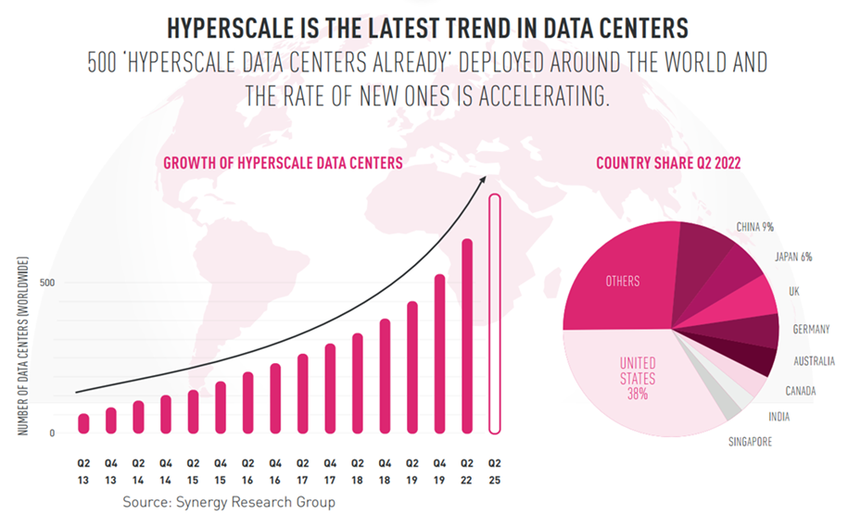
Hyperscale DC growth (trend)
Notes:
Because of the traffic ongoing trend, service/content providers are evolving their Datacenters, to be able to grow into Hyperscale to be able to address such demand on existing internet contents;
Hyperscale data centers are massive business-critical facilities designed to efficiently support robust, scalable applications and are often associated with big data-producing companies such as Google, Amazon, Facebook, IBM, and Microsoft.

Slide 7
IMAGINE
A Security solution that:
Addesses businesses of ALL SIZES
Scalability - Easily scale more gateways
Resiliency – Fully Redundant
High Availability - No downtime
Maximizing cost-efficiency (full active)
Notes:
Adapt to every customer reality and scale
Allow to grow in steps, according to the company’s needs
Fully redundant

Slide 8
Hyperscale technical solution
Check Point Maestro
Security at Hyperscale
Operational Efficiency
Cloud-Level Resiliency
Up to 52 Gateways capable of 1.5 Tbps of Threat Prevention Performance
Spin up new security gateways on demand to accommodate your dynamic security needs
Full active-active redundancy to completely utilize all your hardware resources

Slide 9
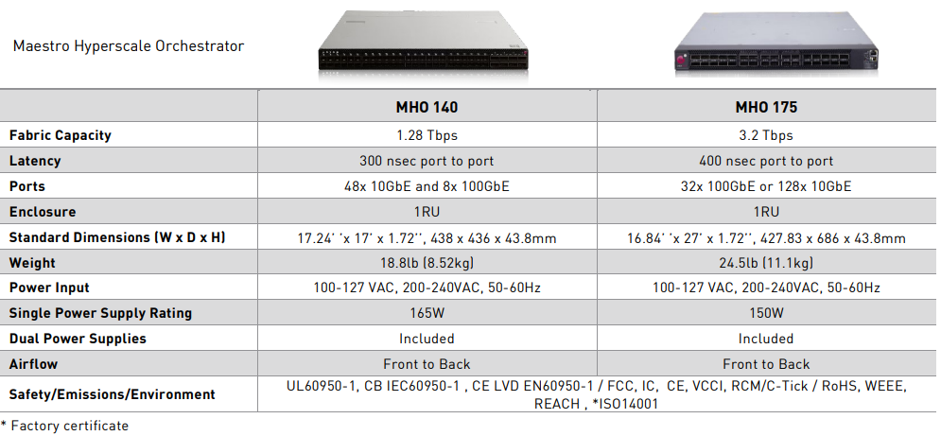
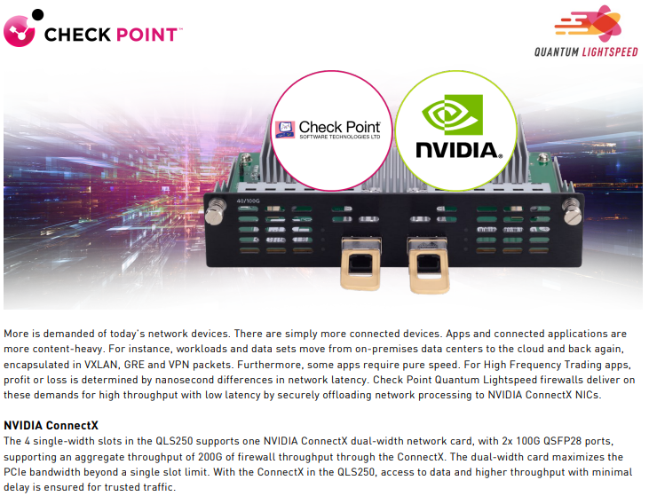
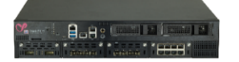
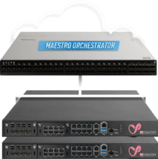
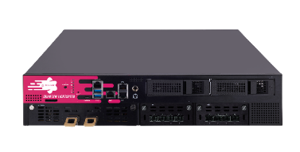
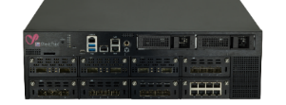
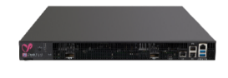
MHO models and supported appliance models
Small Enterprise
Midsize Enterprise
Large Enterprise
LE / DataCenter
Data Center
Telco and High-End
SG6600/SG6700
SG6900/SG7000
SG16200
QLS250/450/650/800
SG26000
SG6200/SG6400
SG16600HS
SG28600HS
Up to 2,5 Gbps
Up to 7,4 Gbps
Up to 17.6 Gbps
Up to 33Gbps
Up to 30Gbps
Up to 1.5 Tbps

Slide 10
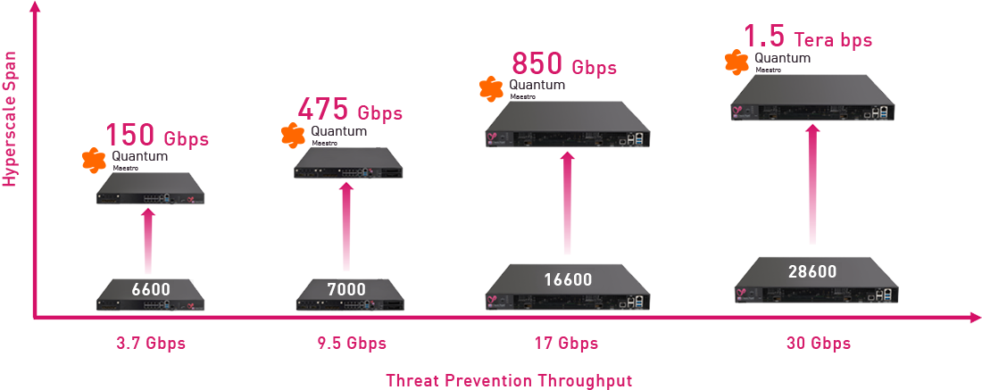
Leap to Hypercale
Notes:
Per the graph we saw - traffic doubles every 3 year
This allows the ability to grow in steps, without the need to make an upfront investment do address the potential demand that will come only within the next 2 or 3 years.

Slide 11
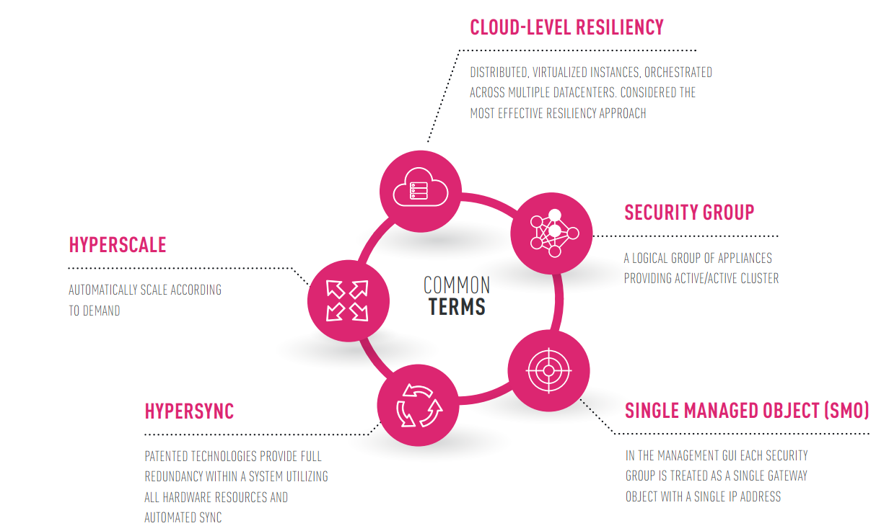
Important acronyms
VSX – Virtual System Extension
MHO – Maestro Hyperscale Orchestrator
SGM – Security Gateway Module

Slide 12
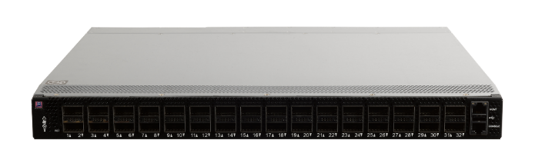
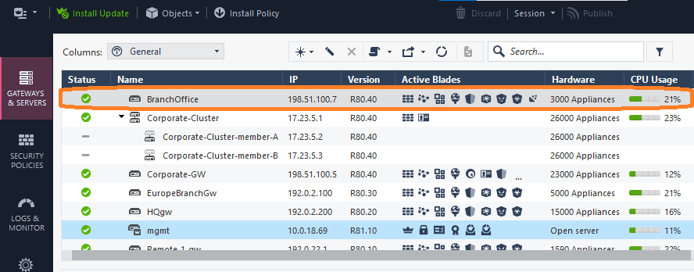
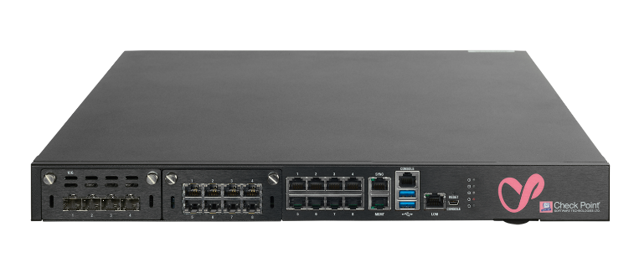
Supported Architectures
Dual-Site
Single-Site
Single-Site
To DC LAN Switching
To DC LAN Switching
MHO
Cluster
MGT
sync
MHO
Cluster
MGT
sync
To SGMs
To SGMs
*SG1
*SG1
*SG2
*SG2
*Each security group is visible as an SMO (Single Management Object) from a management perspective

Slide 13
Security group configuration (video)

Slide 14
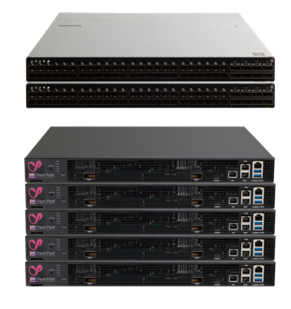
Design-at-will with Security Groups
Physical Implementation
Up to 8 Security Groups
Up to 31 appliances in Group
Logical Implementation
1 or 2 Maestro Hyperscale Orchestrators
Security Groups
Up to 52 Security Gateways in a system
PERIMETER
INTERNAL SEGMENTATION
Virtual Systems
VS
VS
VS
VS
VS
Each Security Group is an independent security gateway segregated from other security groups

Slide 15
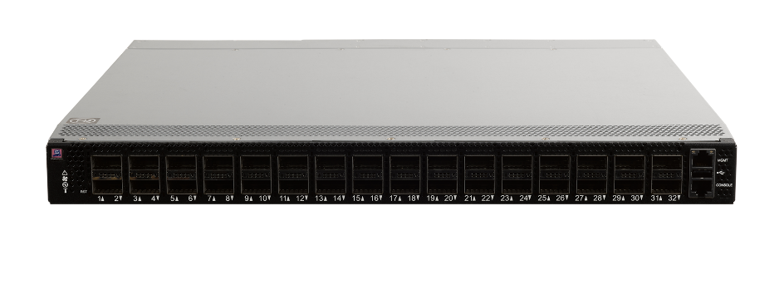
Maestro Clustering
Active/Active
Load
PATENT
HyperSync
Cloud-Level Clustering
Telco-Grade Technology
Connection A
Full Redundancy within a system
Connection B
Cost Efficient N+1 Deployment
Connection C
All Hardware resources utilized
Notes:
Cluster degradation is due to the huge load imposed by the sync process – more appliances in the cluster => more sync load – CP supports only upto 5 due to this reason.
Hypersync addresses this matter in a simple but very smart way.

Slide 16
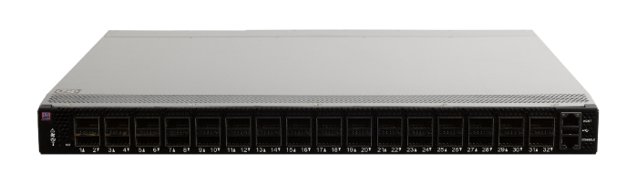
Session Distribution (Hypersync)
Security Group
Load
SGM1
A
SGM2
C
C
A
C
D
B
SGM3
B
SGM4
B
B
D
SG1

Slide 17
Standard Clustering VS Hypersync
MAESTRO ORCHESTRATION
Standard Clustering
Three Devices
3 Gbps
Two Devices
1 Gbps
N+1
99.999%
The power of a single device. The second is just a backup
TRIPLE the performance by load sharing with true LINEAR SCALE
1 + 1 = 1
SIMPLE MATH
1 + 1 + 1 = 3

Slide 18
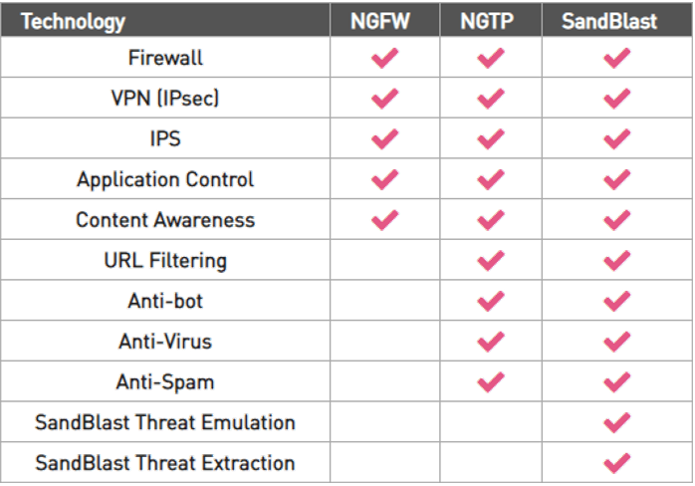
Supported Features
Dual-Site
Single-Site
Single-Site
R81.10 (GA – Recommended)
- Code Unification (MHO, GWs)
- Full Inspection (NGTP/SNBT)
- Dynamic Routing
- IPv4/IPv6
- VPN (Remote Access & Site-to-Site)
- VSX
R81.20 (GA)
- Auto-Scaling
- MVC (Multi-Version Clustering)
- CoreXL Dynamic Balancing
- MDP (Management DataPlane Separation)
MHO
Cluster
VS1
VS2
SG1
SG1
VS1
VS2
SG2
SG2

Slide 19
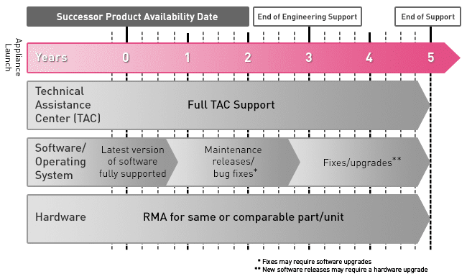
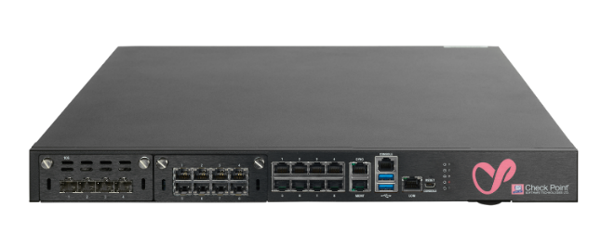
Mix & Match
Investment protection with Maestro
- “Old Appliances” + “New Appliances” - (Same #CPU’s)
- Add new appliance models to SG when released
- Continue growing when current HW models are EOS
- Flexible HW upgrades – change HW models “on the fly” (plug-and-play)
Notes:
Allows for phased rollout of new solution, inserting new appliances without downtime.
Distributes the investment thurought the time.

Slide 20
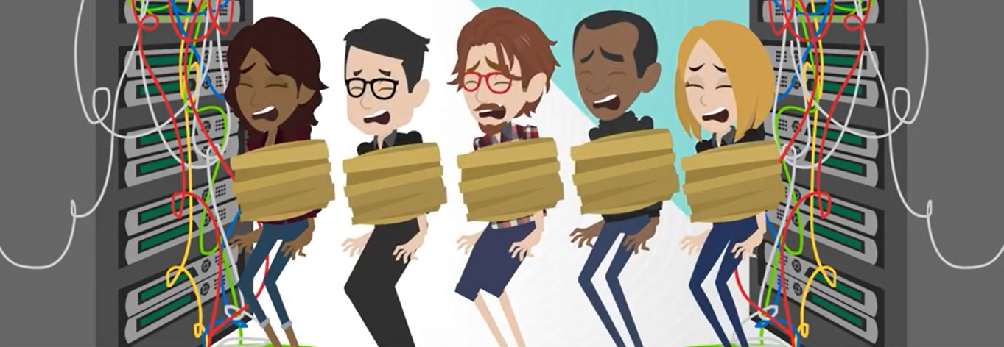
Auto-Scaling
Load
Based on defined performance thresholds
CPU Usage
Number of Connections
Throughput
CPU 50%
Connection A
CPU 50%
Load is distributed automatically
Zero Downtime
Effortless
Connection B
CPU 50%
Unassigned Appliance (Pool)
Connection C
Wait between 8 to 10 min

Slide 21
Auto-Scaling (video)

Slide 22
Maestro Hyperscale - Roadmap
R81.20 main Maestro features
Dynamic balancing for Maestro
Balancing cores utilization in SP
Fast Policy
reduce the policy installation form >10 min to seconds
Fast Forwarding
accelerate trusted traffic upon match of policy rule at the mho level
Connection upgrade / MVC
Zero downtime of the upgrade
MDPS
Data plane separation
Auto scale
Shifting GWs between SGs based on utilization
R82 main Maestro features
Automation (API Improvement)
VXLAN (VTEP)
SD-WAN
Cloud MGMT Support (Smart-1 Cloud)
VSX-Next (Abstraction from the MGT platform -> API Driven)

Slide 23
SUMMARY
Simplicity & Operational Efficiency
Low Risk
Grow without downtime
Investment Protection
Modular Scalability
Grow in steps (Big, Medium, Small)
Adaptable to any business!!!

Slide 24
Thank You!
Q&A

