Slide 1
Research
Platform
FCCN 2023 Conference
June 2023

Slide 2

Challenges
Bad UX – Python, Bash, Slurm
    Hard to build, share and reuse algorithms and workflows
    Assembling the “building blocks” requires writing code
    Compute infrastructure requires writing code
Results are hard to reproduce
    Lots of calculators and scripts with different data formats
    Data is not collected and managed consistently
    No automatic checkpointing
Research cycle is long
    Hard to query across all available data
    Code in low-level languages is hard to optimize
    Surrogate models are few and far between
    ML models are trained manually by data scientists

Slide 3
Research Platform MI platform covers tasks of:
Software developer
Data scientist
ML Engineer
Code in various languages, integrate data from different sources
Solve complex problems
with expertise in computer science, modelling, statistics, analytics, math or UX.
Develop systems
that can learn
and apply knowledge.
Visualization Expert
Data Engineer
DevOps
Create and deliver intuitive dashboards, visualizations,
and human-centric UX.
Develop pipelines, construct
tests and maintain a complete architecture.
Ensure optimal use
of infrastructure through
the design and development
of cloud applications.

Slide 4
Common ways to cover modern research processes
Money
3
Hire professionals
(very expensive)
2
Outsource to students
and junior researchers
(high risk of errors and risk
to your reputation)
1
Do it yourself
(highly time consuming)
Time

Slide 5
Research Platform – more time for research
With
Now

Slide 6
Platform Benefits for Different User Groups
Experimental
Researchers
Computational
Researchers
Head of Lab
Students
Material scientists, particle physicists, bio-chemists, robot inventors
Reproducibility of the research
Database of the computational methods
Database of the articles with smart searching tool
Collaboration tools that allow to engage research groups of other universities
Auto-generated Interactive Publications
Analysts, ML Engineers,
MI-experts
Support of all required Software tools for research
Environment package manager
Workflow manager for automation of routine compute tasks
Dataset visualization
Program & academic managers
Access to elastic compute infrastructure with manageable catalogue of environments
Preconfigured tools for continuous research and collaboration
Embedded experiment reproduction capability for any research run on the platform
Bachelor, Master & PhD students
Run educational projects
Play with and customize templates to learn common methods
Easy access to compute resources
User friendly interface that do not require special expertise to run experiments
Possibility to work in group on the same project and share information, knowledge and experience

Slide 7
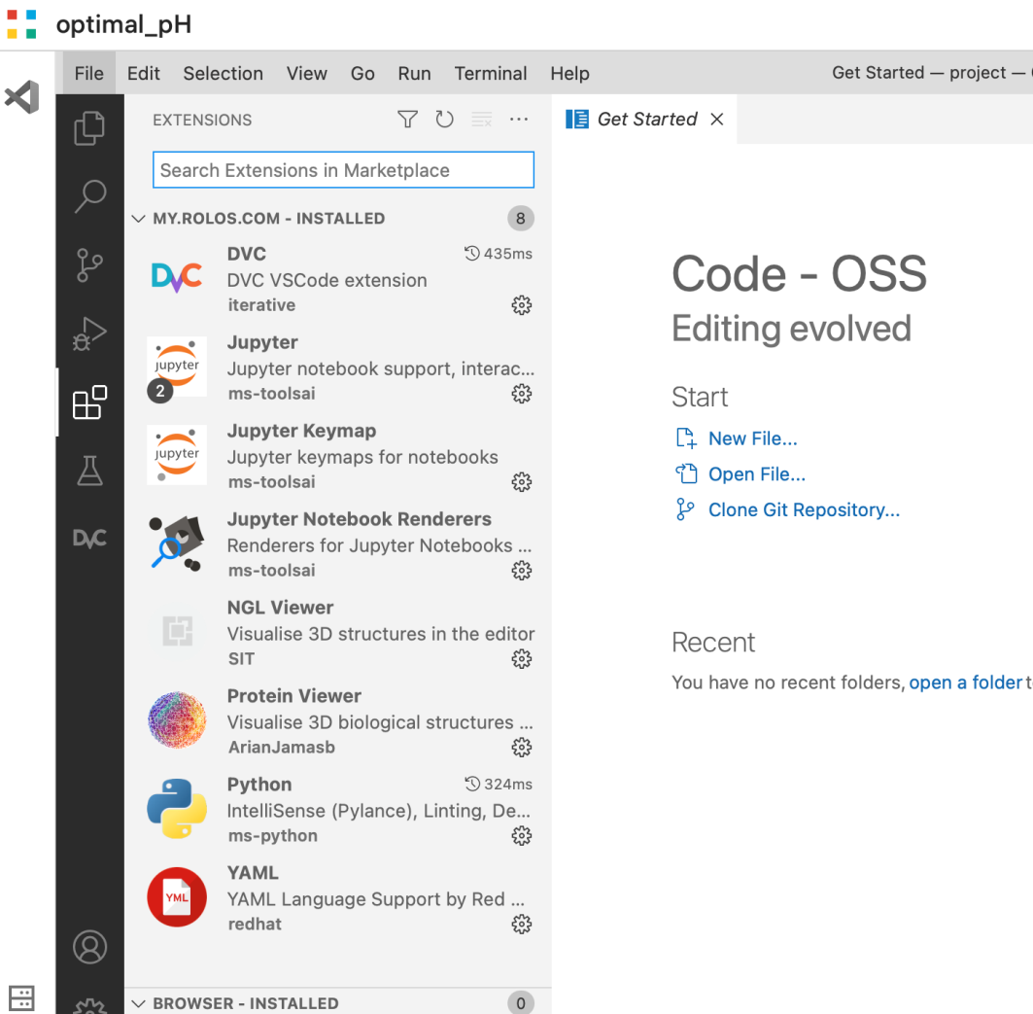
Domain Adaptability
Domain specific languages for data and operations
Domain specific algorithms and visualizations
Extensive data and algorithm library with extensive search capabilities
Robust SDK for easy custom domain-specific integrations
Source Code Access for advanced fine tuning

Slide 8


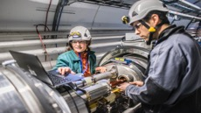



Cloud & Hardware Agnostic
Research Platform Datacenter
Research Platform Frontend
Storage & compute cloud integration (Azure, AWS, GCP, S3, etc.)
Cross-architecture support (CPU, GPU, Quantum, etc.)
Deep integration with virtualization & local storage (VMware, Virtuozzo, K8S, SAN, etc.)
Smart cost optimizer
Research Platform Backend
Research Platform Abstraction Layer
HPC cluster
Private compute and storage
Public Clouds
Private Clouds
Quantum Hardware
HPC cluster
Storage cluster

Slide 9
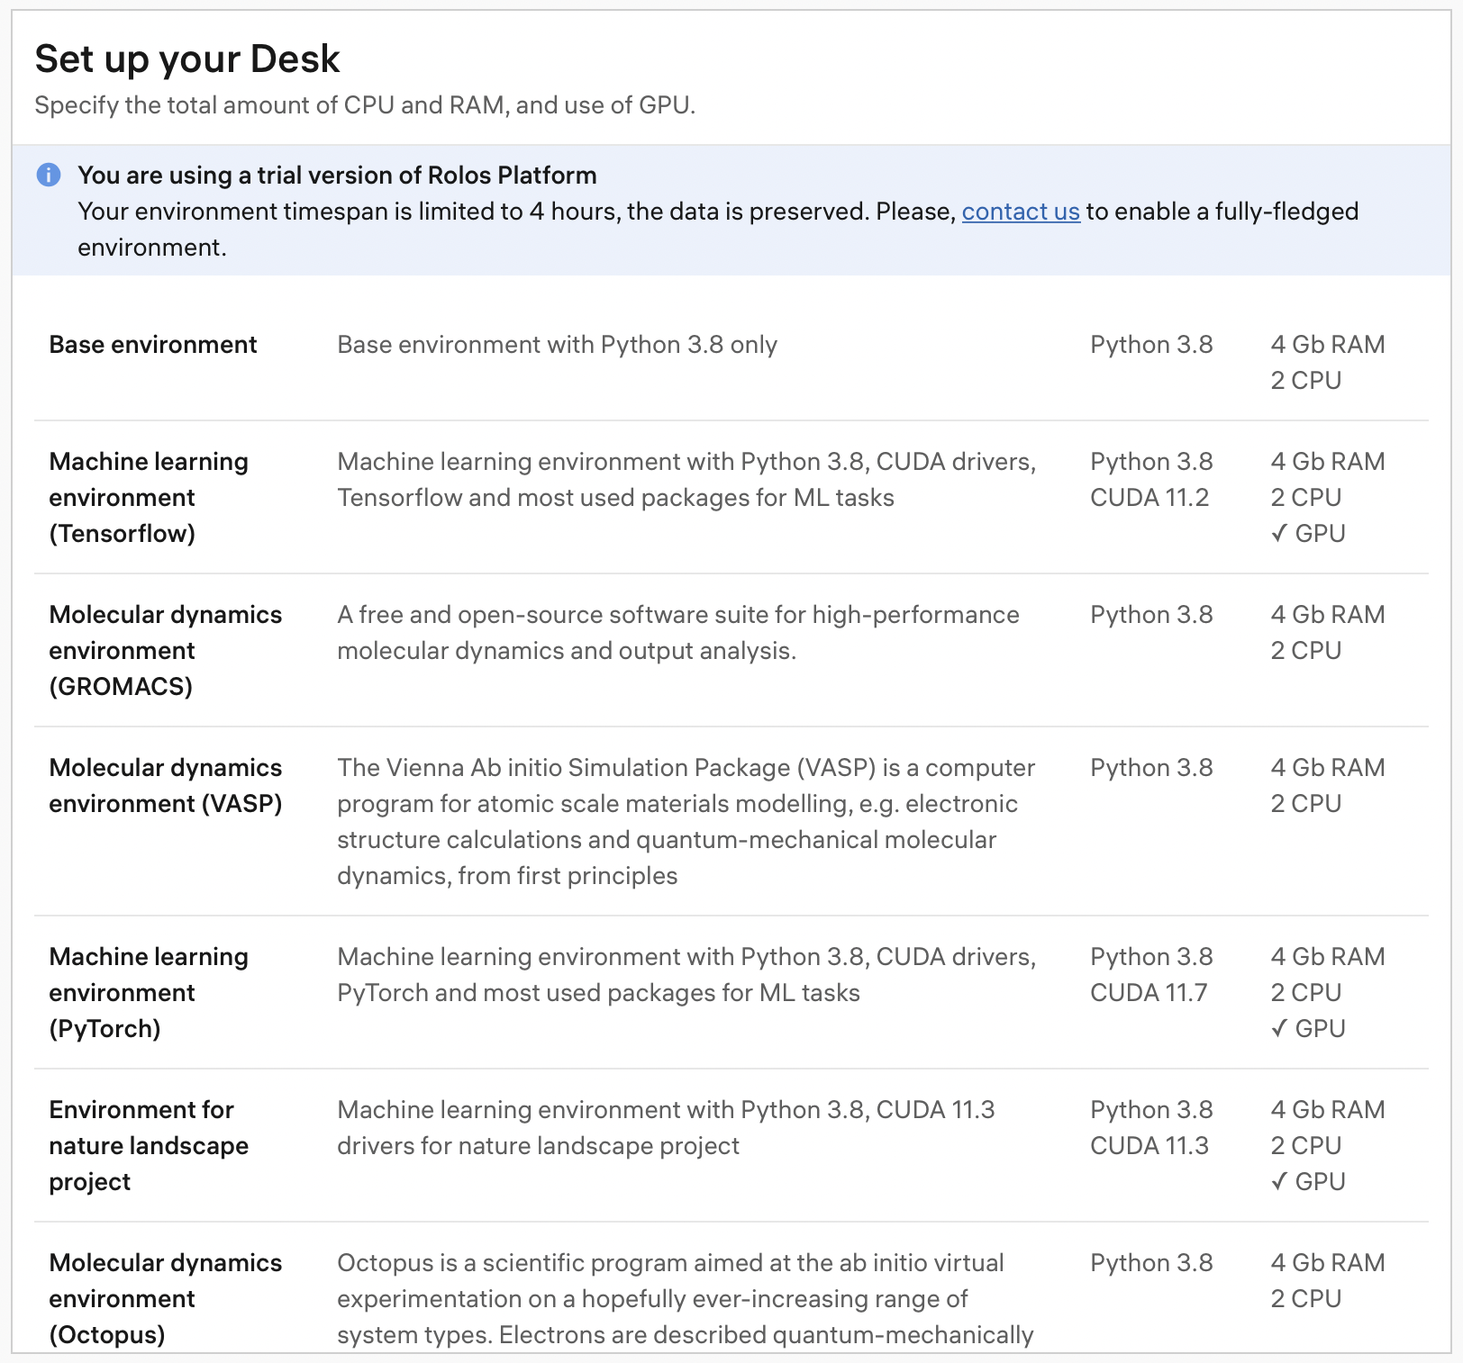
Experiment in the Desk with VScode
Description
  Ready to use environments with all packages required to start research
  Pre-installed VScode with Jupyter functionality
Value proposition
  Fast start with validated and ready to use environment with all basic functionality included
Use-case
  Researcher provision resources which suit project requirements
  Project collaborator experiments with the data and code
  Project collaborator shares the results with other project members

Slide 10

Data & Code versioning
Project meta-versions (L1)
User A meta-versions (L0)
Aggregating code, dataset and artifact selective versions into so-called joint meta-versions
Automated code (Git) + data (DVC) versioning
Covering different version control systems and file/object storages
Switching between meta-versions of projects recommended by researchers
Cross-project sharing and selling of meta-versions
Other storages
User B meta-versions (L0)
User C meta-versions (L0)
User D meta-versions (L0)
- Version of code, dataset and artifact

Slide 11
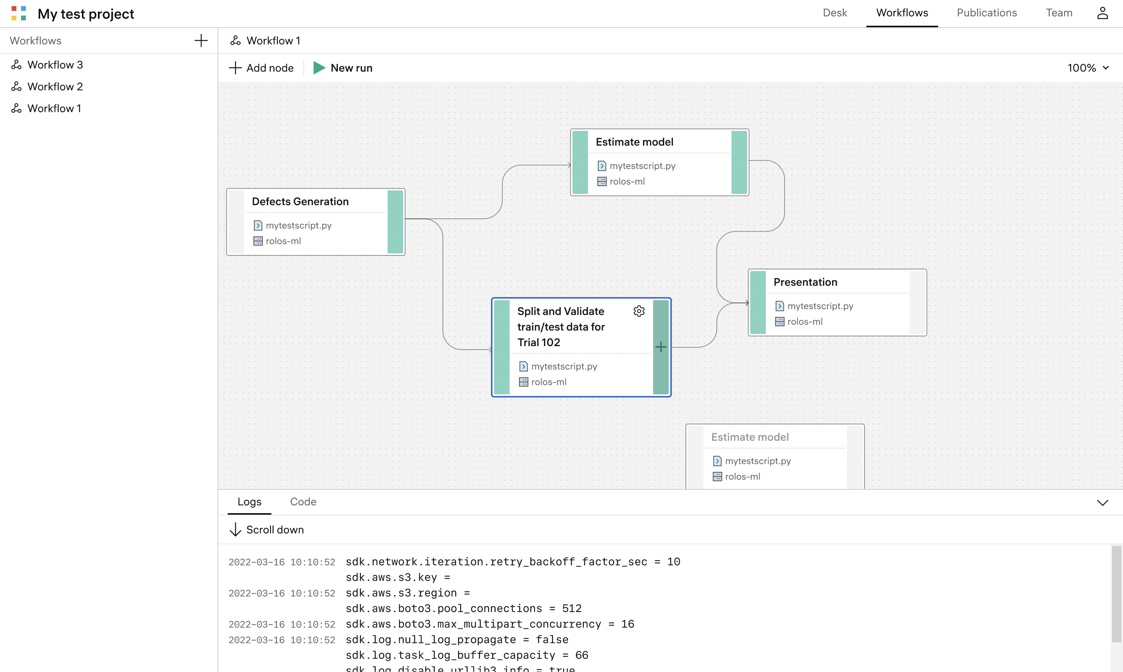
Collaborative workflow manager
Description
  Research pipeline visualisation interface which provides ability to decompose steps of the research
Value proposition
  Enabling collaborative research for external and internal teams to ensure reproducibility of the experiment
Use-case
  Research team member can organise the data processing pipeline in a form of a graph
  Each node of a graph can represent the code of a particular step of that pipeline to be launched within whole pipeline or separately
  The pipeline can be shared with other research teams for their feedback

Slide 12
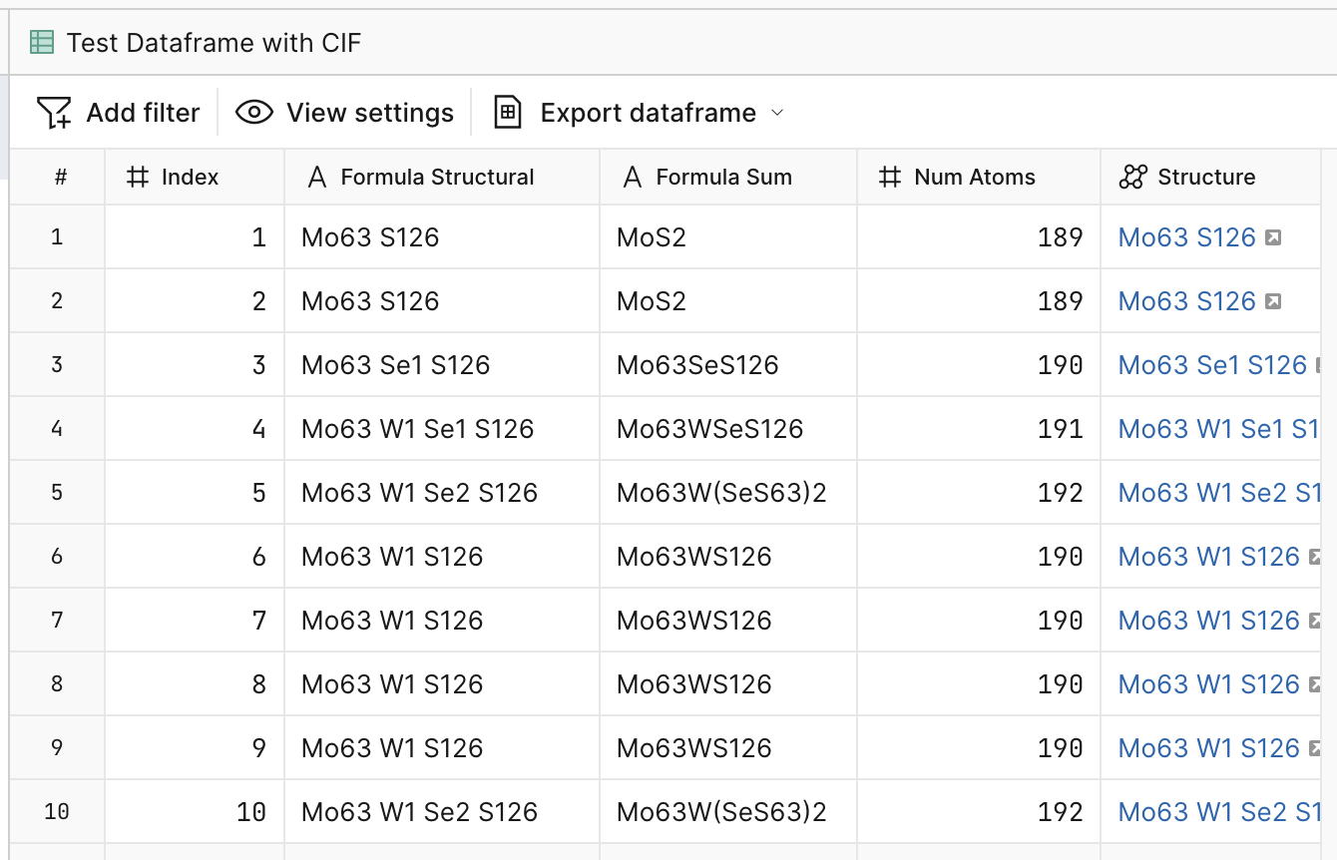
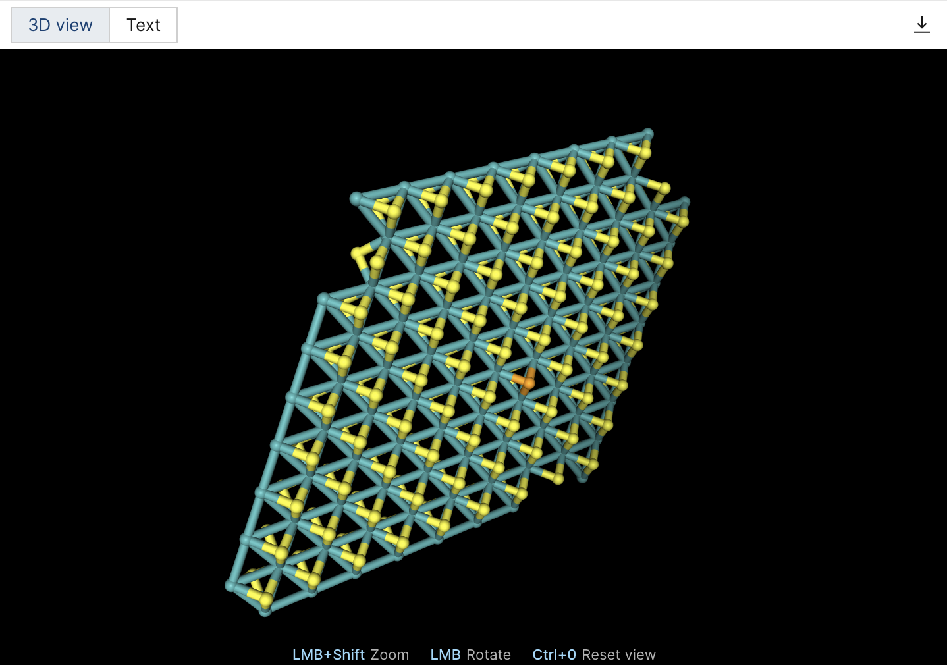
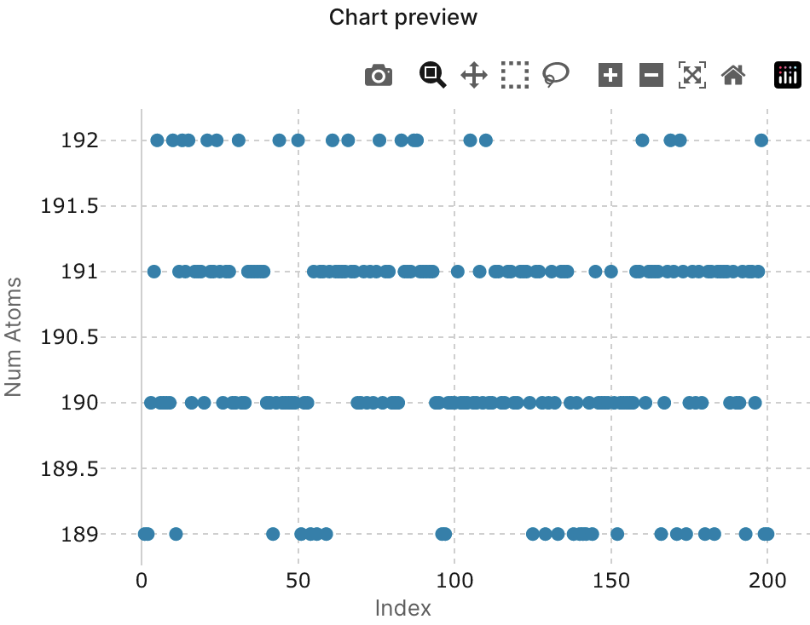
Data Catalog
Instant visualizing of research results
Variety of filters and view settings
Easy export and sharing of results
Collaborative contribution
Interactive charts

Slide 13
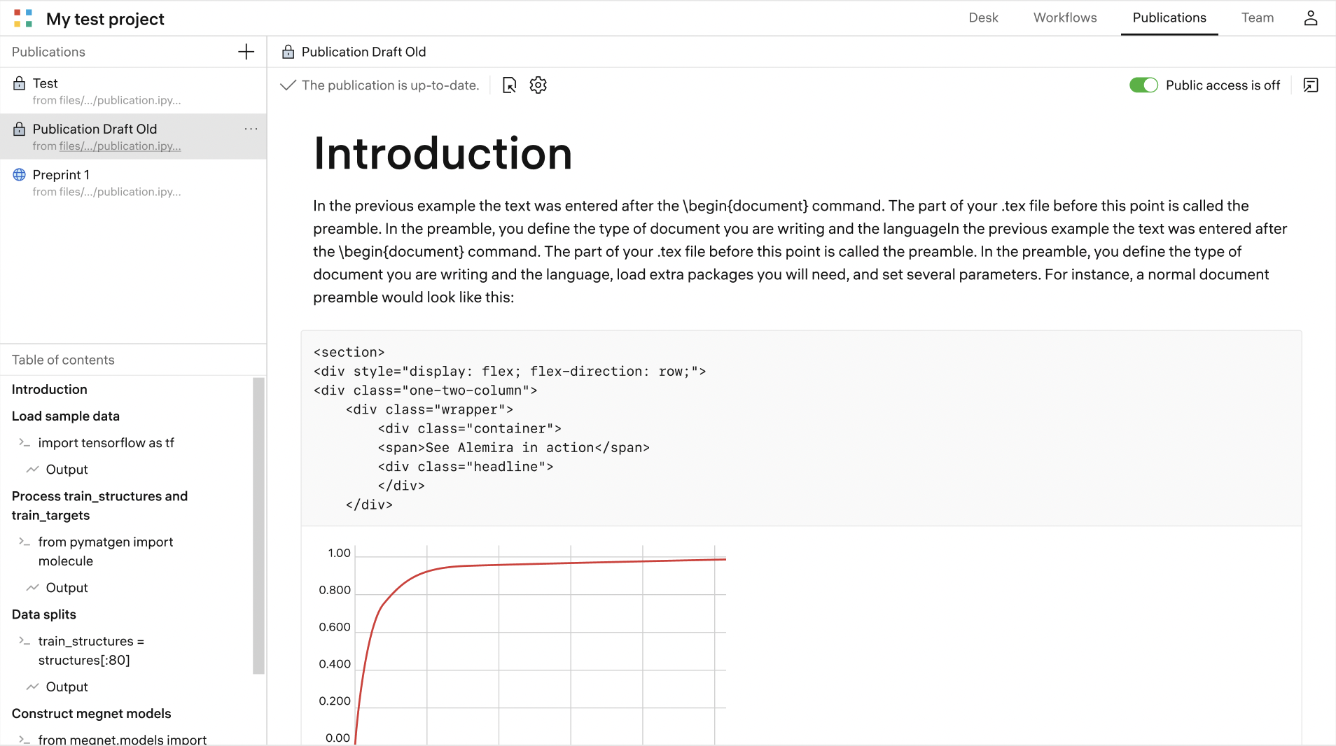
Interactive Publication
Description
  The automated instrument to convert the research-based coding into a publication with interactive elements
Value proposition
  Enabling publication reviewers interact with the research artefacts of a scientific article to gain more quality feedback through exploring the results and experimentation
Use-case
  Publish research results as an interactive paper by using existing research based-code
  Share access to the materials of the research project
  Allow reviewers to interact with research artefacts and reproduce experiments within own lab
  Customise publication and track changes within different versions

Slide 14
Try Research Platform https://my.rolos.com/sign-in

Slide 15
Thank you!
Contact us
aa@constructor.tech

