Slide 1
AI-Native
Experience-First Networking
AIOps aplicados à rede do campus.
Notes:
Delivering an exceptional experience everytime

Slide 2
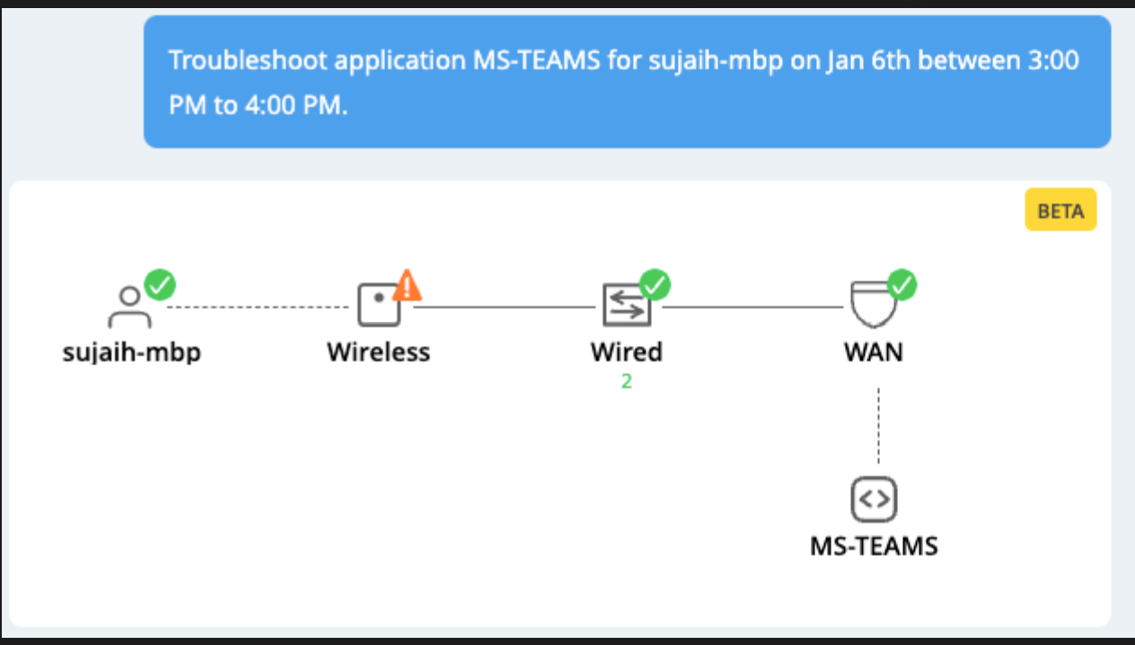
Enable IT to be Proactive: “Up” is not the same as “Good”

Slide 3
“
“
I´m connected to Eduroam, but I still can’t load new emails.
My phone has full bars, but my Zoom call keeps going in and out.
”
”
Connectivity is not the same as experiencing a great connection
“
“
My internet is down but there are no outages reported.
I’m connected, but my video is pixelated.
”
”
Notes:
At Juniper, we believe that connectivity is not the same as experiencing a great connection.

Slide 4
We need a different approach
Notes:
The legacy way of viewing networks and the value they bring to the world has changed.
We need a different approach.

Slide 5
Experience-First approach changes everything
We start by asking the right Experience-First questions—so that everything we do is designed to deliver better end user and operator experiences
Notes:
When you shift from simply measuring connectivity to instead focus on the experience of the end-to-end connection—everything changes. A new vision of networking becomes possible.
This is what we mean when we say Experience-First. And Experience-First changes everything.
Only Juniper Networks takes an Experience-First approach that solves for the biggest challenges that operators and end users experience every day.

Slide 6
AI-NATIVE NETWORKING PLATFORM
We start with Experience-First questions
“How do we ensure every user, in every location, is getting a consistent experience?”
“Can the network adapt to fix issues before users even know they exist?”
EXPERIENCE–FIRST
“Does the network meet the needs of all necessary stakeholders?”
Notes:
(Experience First)
With our relentless focus on the experience, we're not simply asking ‘is the network up?’ but rather…
”How do we ensure every user, in every location, is getting a consistent experience?"
"Can the network adapt to fix issues before users even know they exist?"
"Does the network meet the needs of all of its stakeholders?”
Then we go about answering these questions.
Let’s look at the ingredients of that answer…

Slide 7
AI-NATIVE NETWORKING PLATFORM
Interoperable, extensible, and secure from client to cloud
EXPERIENCE– FIRST
AIOPS
CLIENTS
COMMON CLOUD
CLOUDS
TRANSFORM NEXT-GEN CAMPUS AND BRANCH
SCALE AUTOMATED WAN
Wired Access
Enterprise Routing
Wireless Access
MODERNIZE DATA CENTER
Core
Location Services
Edge
Secure Branch Access
Metro
Automated Secure Data Center
AI Data Center
Notes:
Our intent is to propagate AIOPs across the entire network
This means every domain
From...
Transforming the NG Campus and Branch where you will see us in 1H '24 take self-driving and optimization capabilities to new heights with integrated synthetic testing.
To modernizing the Data Center. Again, in 1H ‘24 you will see the first VNA for AIOPs across critical use cases for both campus and branch and data center..
To scaling and automating the WAN
There are several important ways that we clearly differentiate ourselves from the competition
First, we had the foresight years ago to build our products in a way that allows us to extract rich network data
And we’ve been learning for years
It would take anyone years to catch up to us just by virtue of how long it will take to learn as much as we (and Marvis) have been learning
And we’re now extending the AI-native platform across more and more domains
In so doing, creating powerful flywheel effects: more domains -> more data -> more learning -> more value to our customers -> more data
What we have today is awesome.
But it’s just the tip of the iceberg.
We are very excited about what’s to come

Slide 8
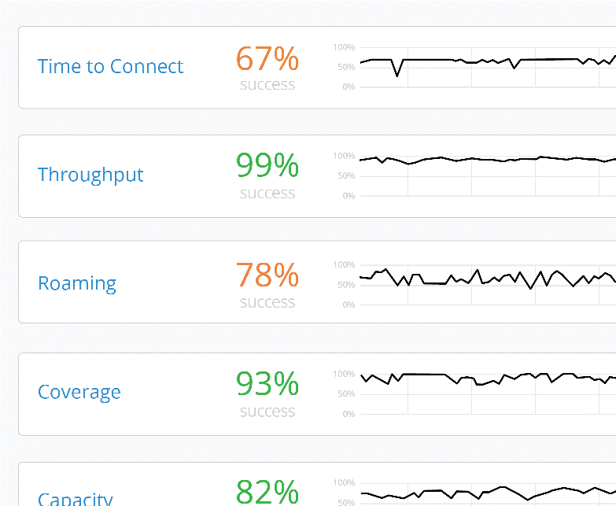
Substantially Better
Key Differentiation
YUM CAFE CUSTOMER
Hi Jeff! Welcome back to Yum Cafe.
Your order is ready for pickup at the counter, see you soon.
Save $2.00
Chicken Fry
Add our signature Chicken Fry sandwich to your order now
$2
Client Level Visibility
AI-driven Operations and Support
Microservices Cloud for Agility
Digital Engagement with Virtual BLE
Underpinned by a 100% Open API driven architecture
Delivered Across the Full Stack
Notes:
Why are the largest and smallest companies moving away from legacy architectures and replacing their networks with Mist? There really are four reasons.
Number one is the user experience. When a device attaches to a network, there are 150 things that can go wrong. The Mist Cloud is tracking every client in real-time and understanding exactly what is happening. That's what allows us to identify an unhappy user proactively before they can call it.
We then couple that information with AI to actually do what a human being would do if they saw what was happening in real-time. We can take packet captures; we can do automated root cause analysis and tell you exactly what is wrong with that client experience, and where in the network it is happening – Wired, Wireless, or WAN.
The third thing is we've eliminated the controller architecture, and move to a modern microservices cloud, which allows us to attain a level of reliability that's never been seen in networking, and at the same time, bring back agility. The fullstack network can evolve at the same rate as the endpoints that attached to it.
And last but not least, we can make the wireless network more relevant to the business. Leveraging Bluetooth technology and a patented antenna array, we can identify people and assets, and we can engage people on their smartphones in the network and provide services that are unparalleled. In a restaurant we can better understand when a customer has, or hasn’t been to a location and present them with personalized offers that can increase brand loyalty, and enhance order size. We can give the business a better understanding of share of wallet.

Slide 9
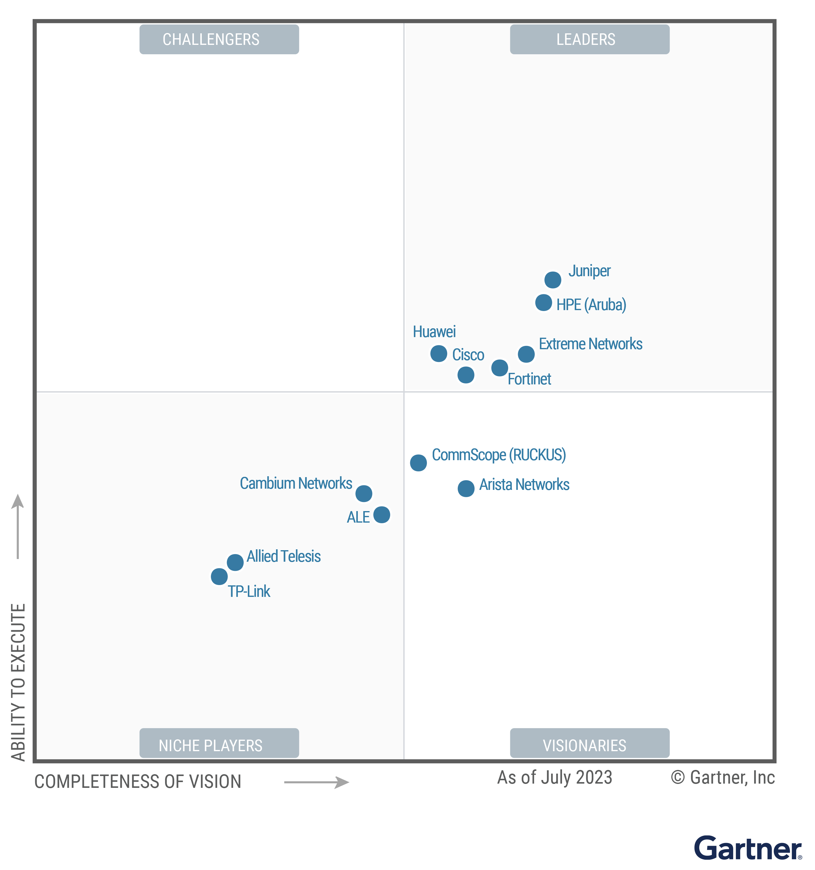
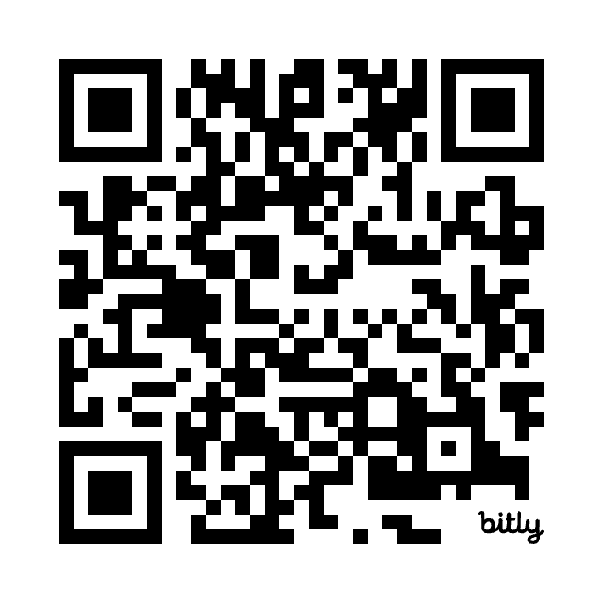
Juniper Networks is a Leader in the 2024 Gartner® Magic Quadrant™ for Enterprise Wired and Wireless LAN Infrastructure
4 Times in a Row!
Read the complimentary report:
https://www.juniper.net/us/en/forms/2024/gartner-2024-mq-wired-wireless.html?utm_medium=outbound&utm_source=QR_Code&utm_campaign=GLBL_CB_2024_ANR_2024_Gartner_MQ_Wired_&_Wireless_LAN&utm_content=single-slide-ppt
4 Times a Leader!
Gartner Magic Quadrant for Enterprise Wired and Wireless LAN Infrastructure, Tim Zimmerman, Christian Canales, Nauman Raja, Mike Leibovitz 6 March 2024.
GARTNER is a registered trademarks and service mark, and MAGIC QUADRANT is a registered trademark of Gartner, Inc. and/or its affiliates in the U.S. and internationally and are used herein with permission. All rights reserved.
Gartner and Magic Quadrant are registered trademarks of Gartner, Inc. and/or its affiliates in the U.S. and internationally and is used herein with permission. All rights reserved.
Gartner does not endorse any vendor, product or service depicted in its research publications, and does not advise technology users to select only those vendors with the highest ratings or other designation. Gartner research publications consist of the opinions of Gartner’s research organization and should not be construed as statements of fact. Gartner disclaims all warranties, expressed or implied, with respect to this research, including any warranties of merchantability or fitness for a particular purpose.
This graphic was published by Gartner, Inc. as part of a larger research document and should be evaluated in the context of the entire document. The Gartner document is available upon request from Juniper Networks.

Slide 10
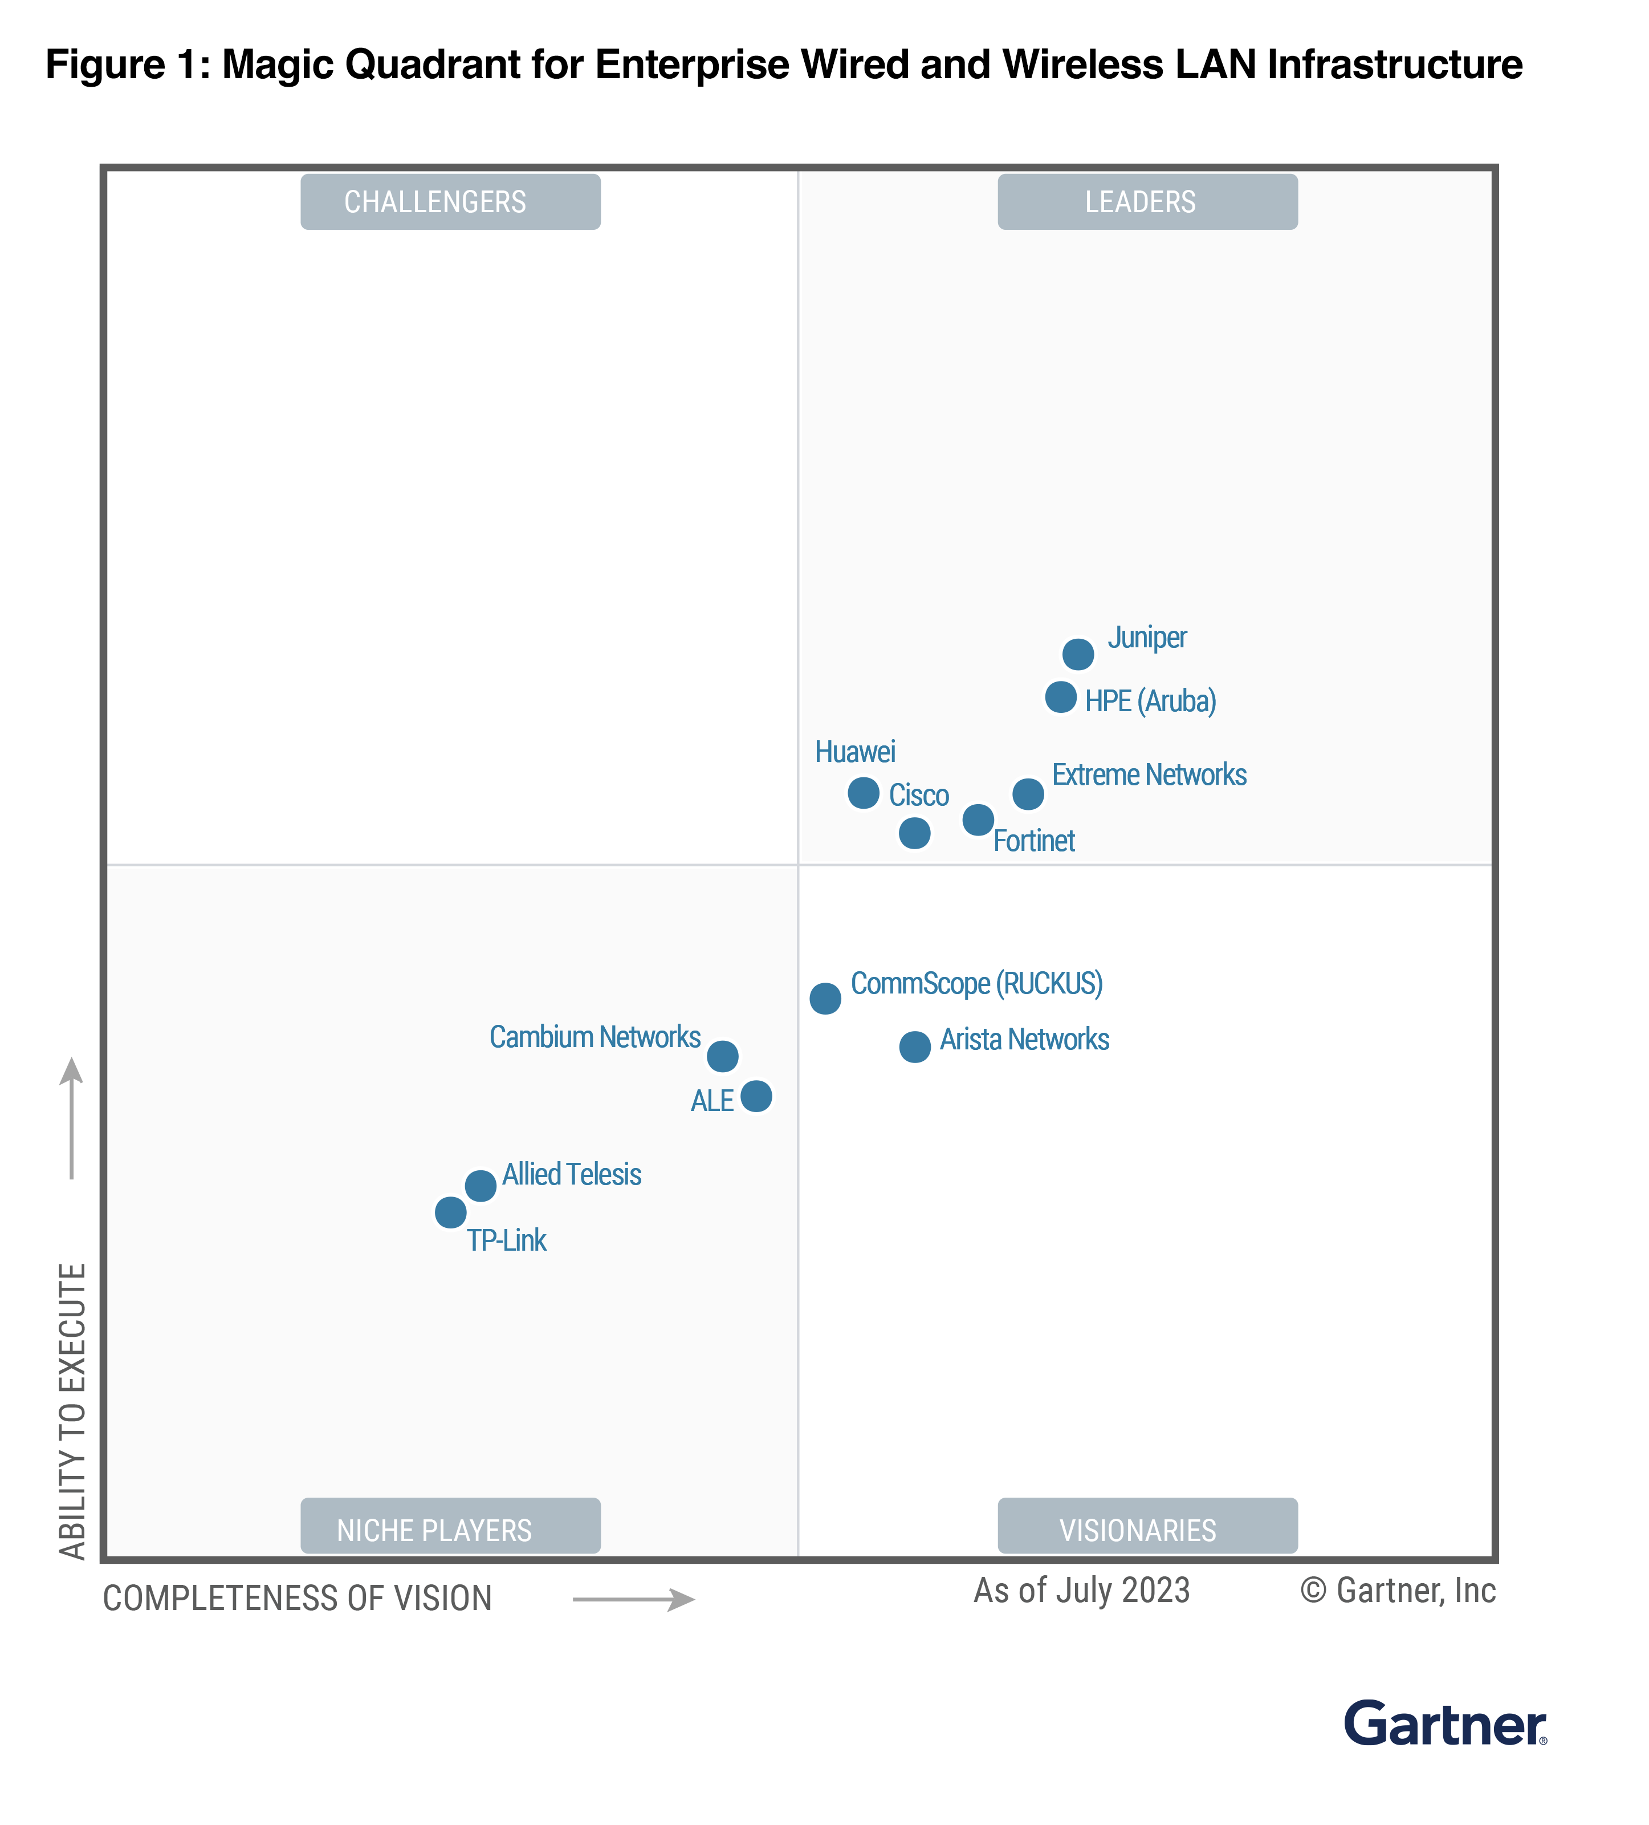
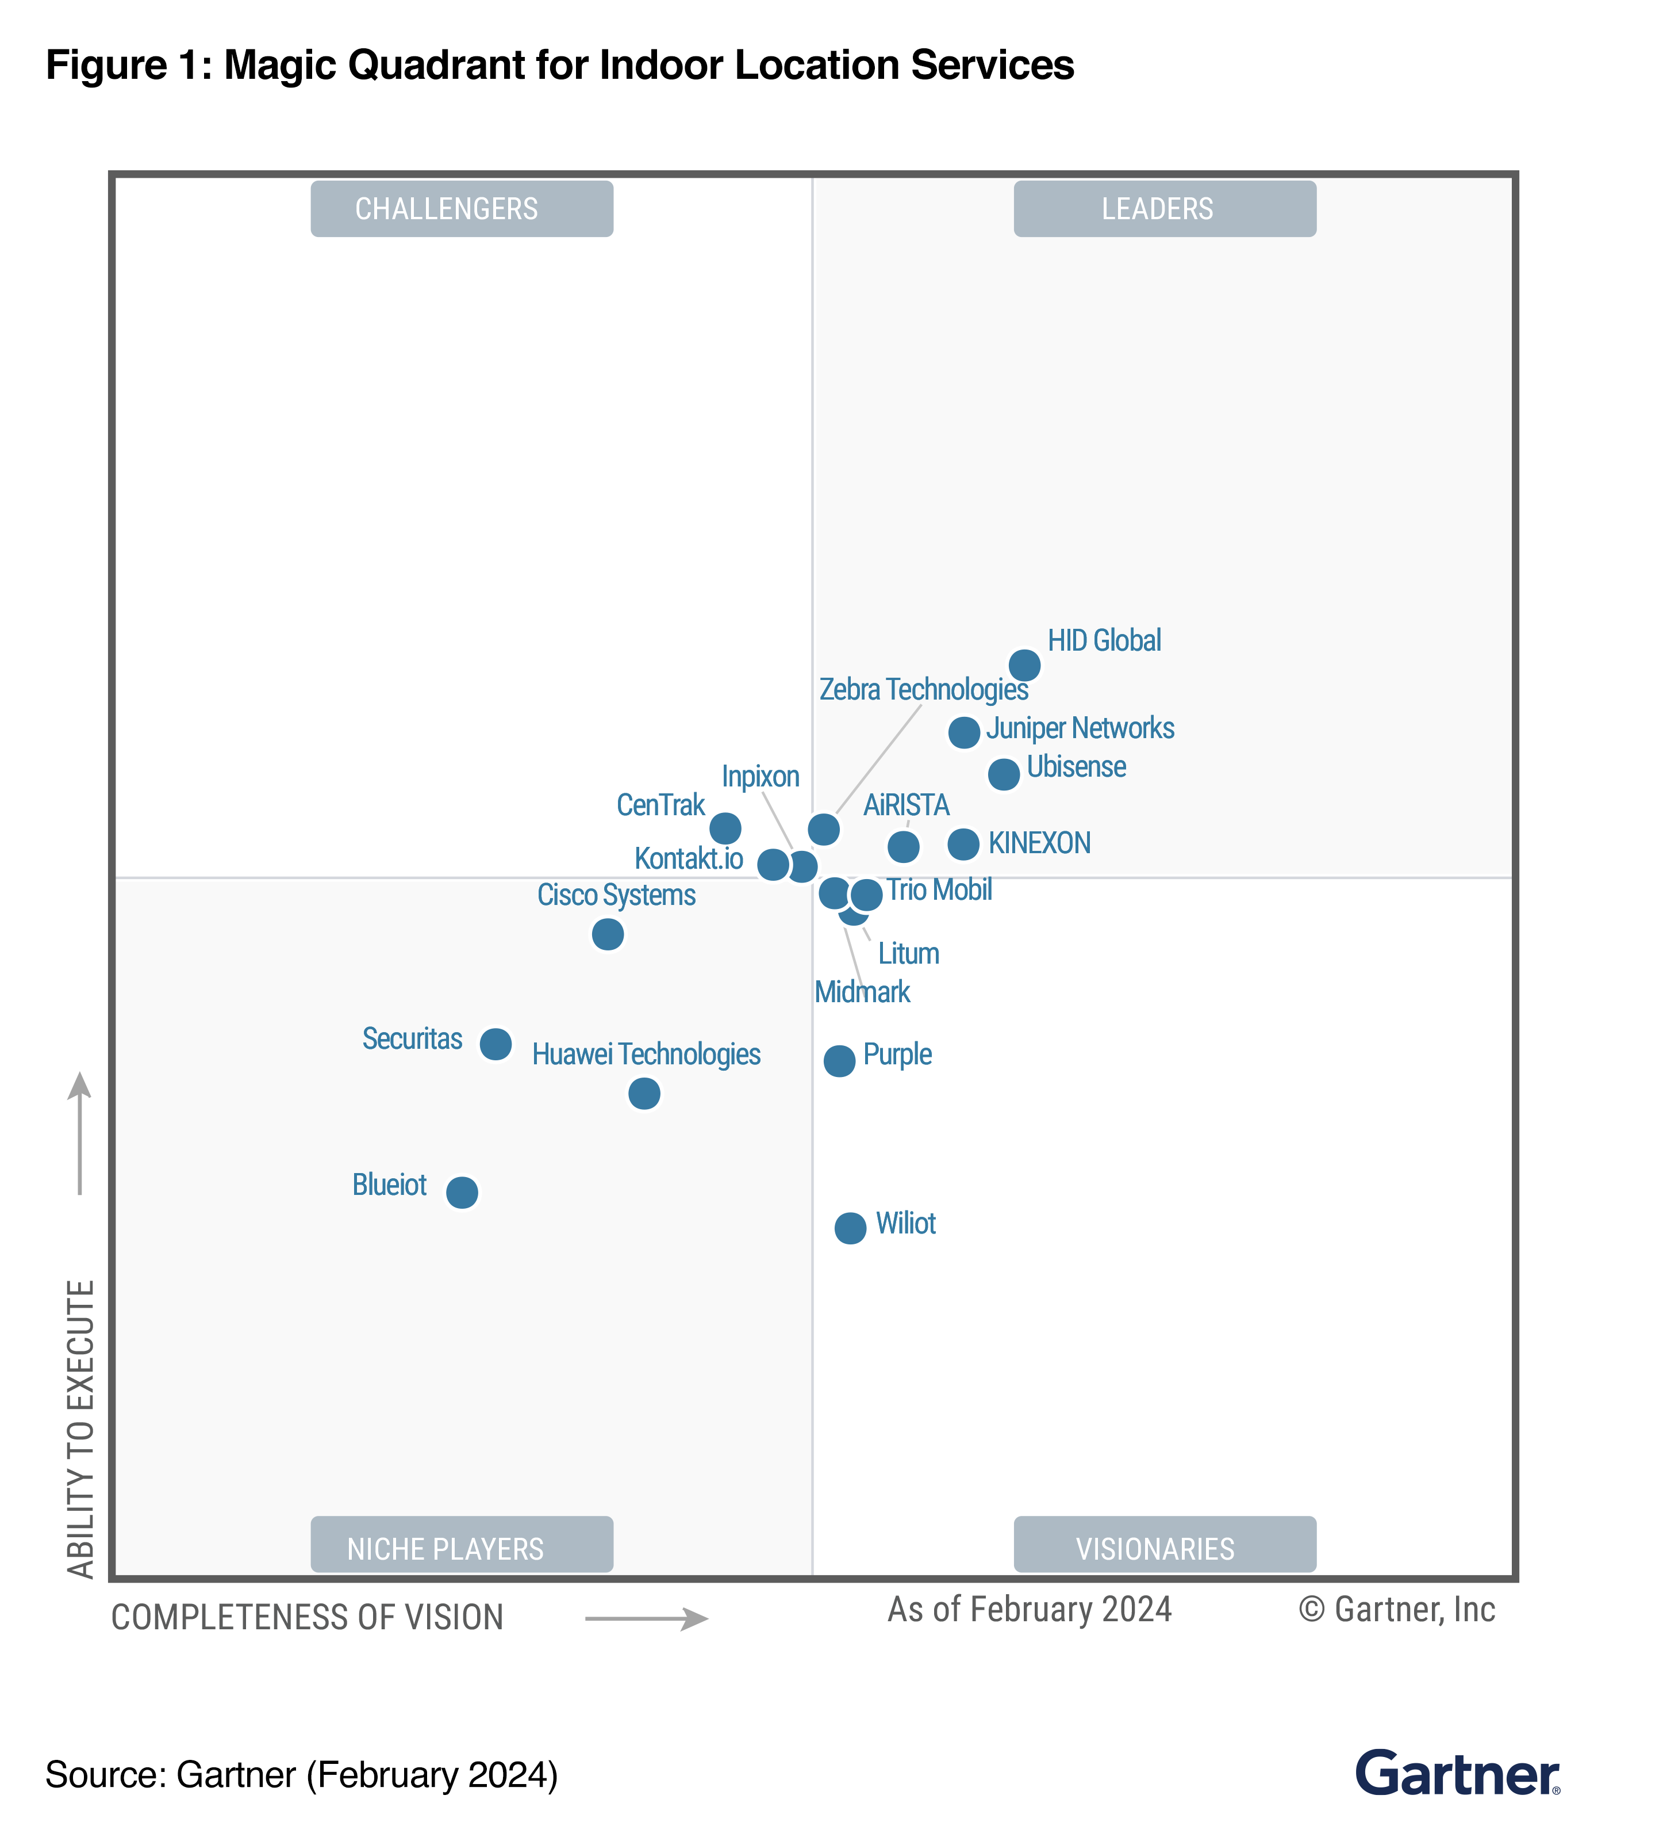
A LEADER 2024
Enterprise Wired & Wireless LAN Infrastructure
A LEADER 2024
Indoor Location Services
Gartner Magic Quadrant for Indoor Location Services, Global, Tim Zimmerman, Annette Zimmermann, Nick Jones 28 February 2024.
Gartner Magic Quadrant for Enterprise Wired and Wireless LAN Infrastructure, Tim Zimmerman, Christian Canales, Nauman Raja, Mike Leibovitz 6 March 2024.
Gartner does not endorse any vendor, product or service depicted in its research publications, and does not advise technology users to select only those vendors with the highest ratings or other designation. Gartner research publications consist of the opinions of Gartner’s research organization and should not be construed as statements of fact. Gartner disclaims all warranties, expressed or implied, with respect to this research, including any warranties of merchantability or fitness for a particular purpose.
GARTNER is a registered trademark and service mark of Gartner, Inc. and/or its affiliates in the U.S. and internationally, and MAGIC QUADRANT is a registered trademark of Gartner, Inc. and/or its affiliates and are used herein with permission. All rights reserved.
This graphic was published by Gartner, Inc. as part of a larger research document and should be evaluated in the context of the entire document. The Gartner document is available upon request from Juniper Networks.
Notes:
If you look at the latest Gartner Magic Quadrant, Juniper leads in both ability to execute and vision, no one else can claim that we are the leader.
Also, if you look at things like indoor location services, we are the only networking vendor in the whole leaders quadrant.
In fact, all the other vendors in that section are our partners.
So again, if you're looking for things like indoor location, looking for things like wired and wireless, we are the leader and visionary in other areas like SD WAN.

Slide 11
AI Stories in Higher Education
Notes:
The legacy way of viewing networks and the value they bring to the world has changed.
We need a different approach.

Slide 12
Higher Ed Institutions are choosing
User Experience
Digital Engagement
Mist is the only vendor in the industry with a cloud built to measure and improve user level visibility
Engage visitors and associates digitally without overlay systems
AI
Microservices Cloud
Mist has the industry’s only Self Driving Network – means fewer tickets and happier users
A modern microservices architecture ensures a network that is easy to operate and agile

Slide 13
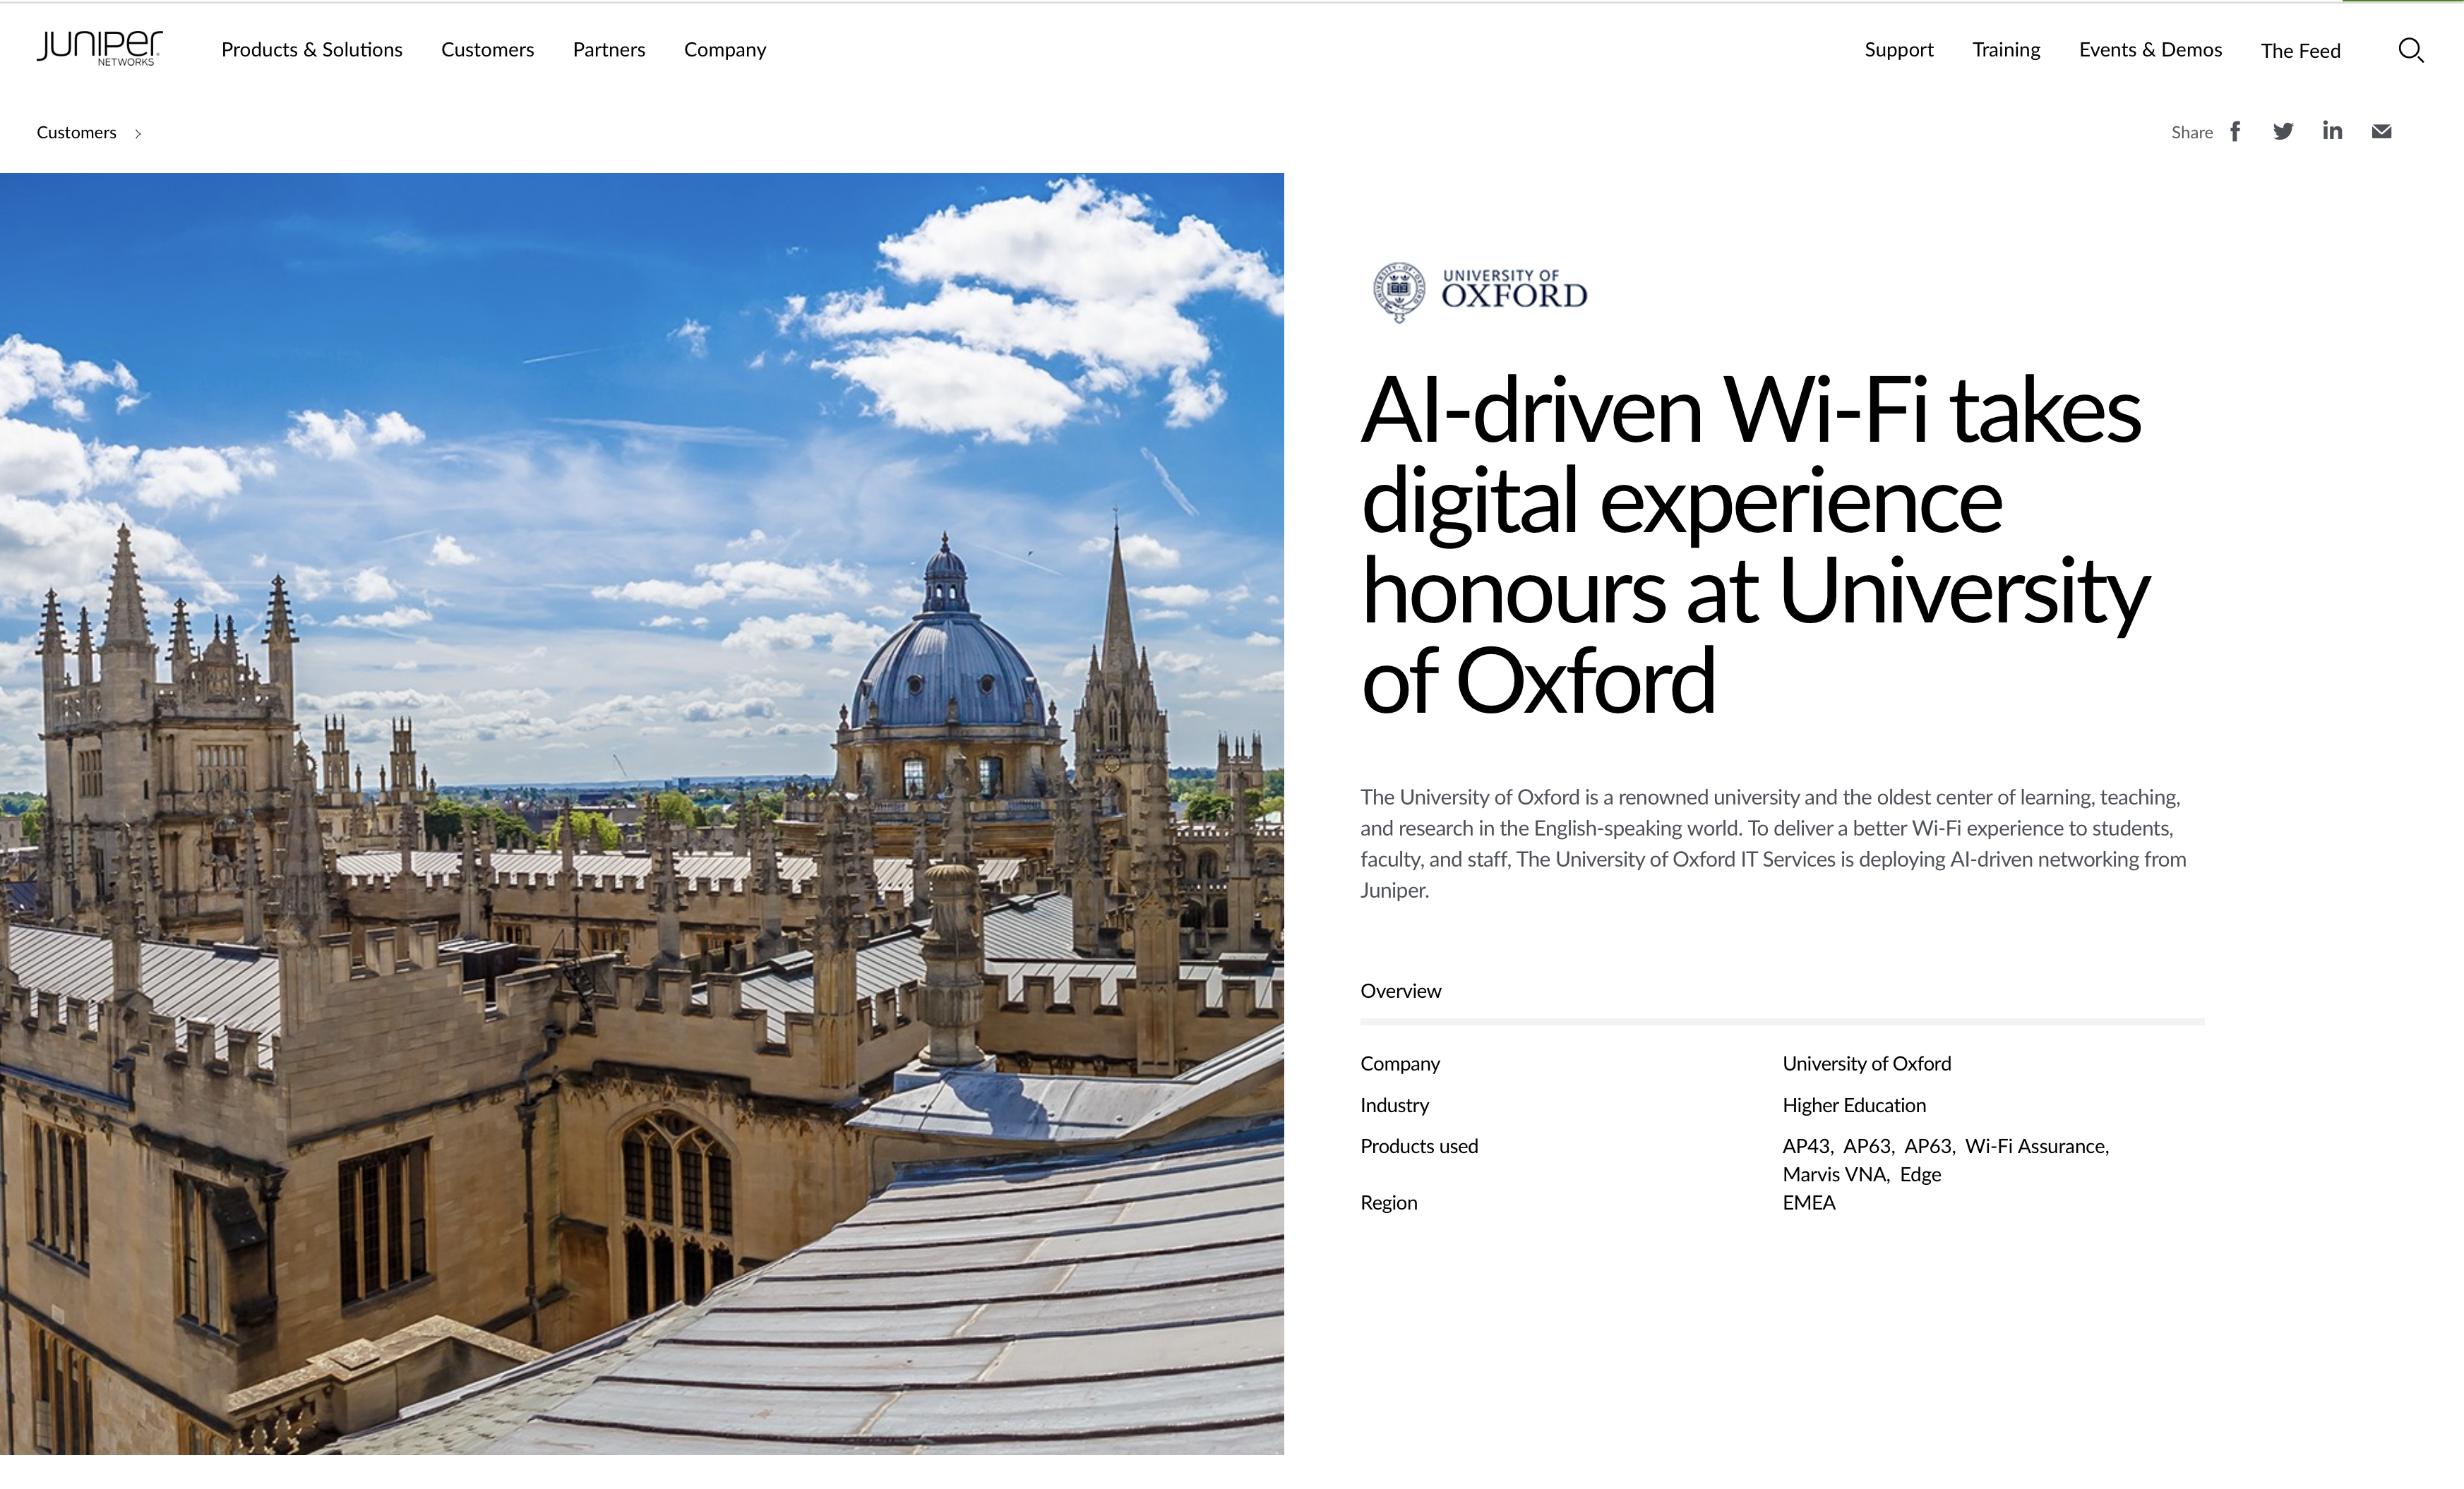
Use case: University of Oxford
25,000 students, including 12,510 undergraduates and 13,044 post-graduates
Provide AI-driven Wi-Fi to support central administration, libraries, colleges, and departments
Quickly identify and resolve transient and hidden problems in the network

Slide 14
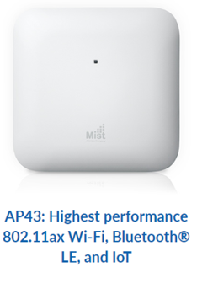
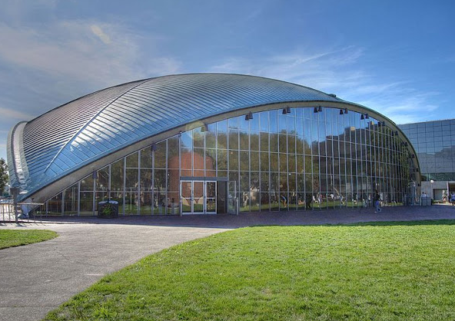
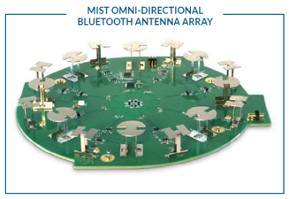
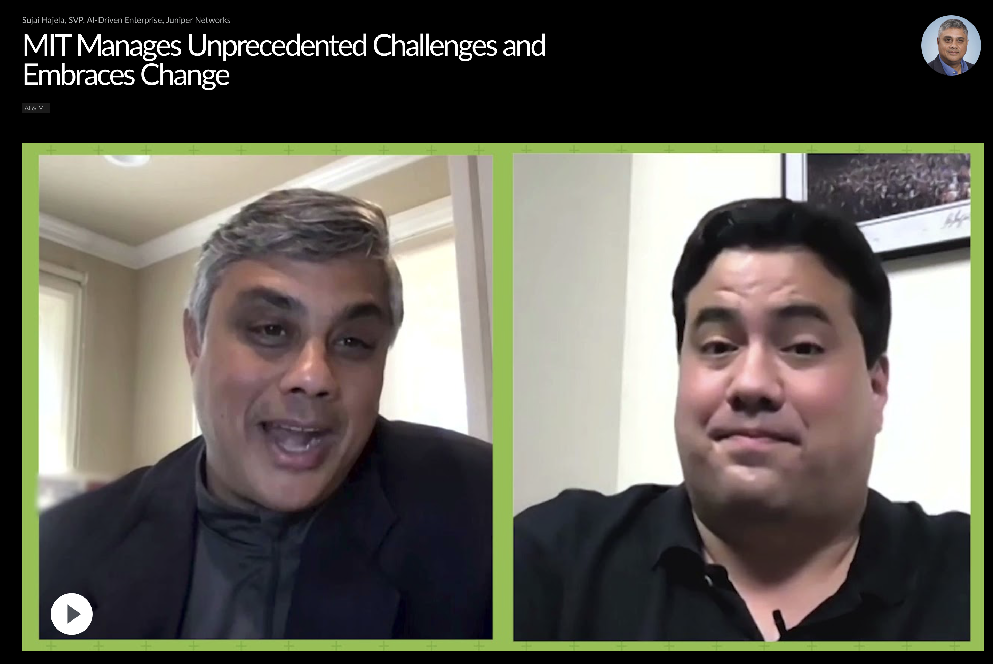
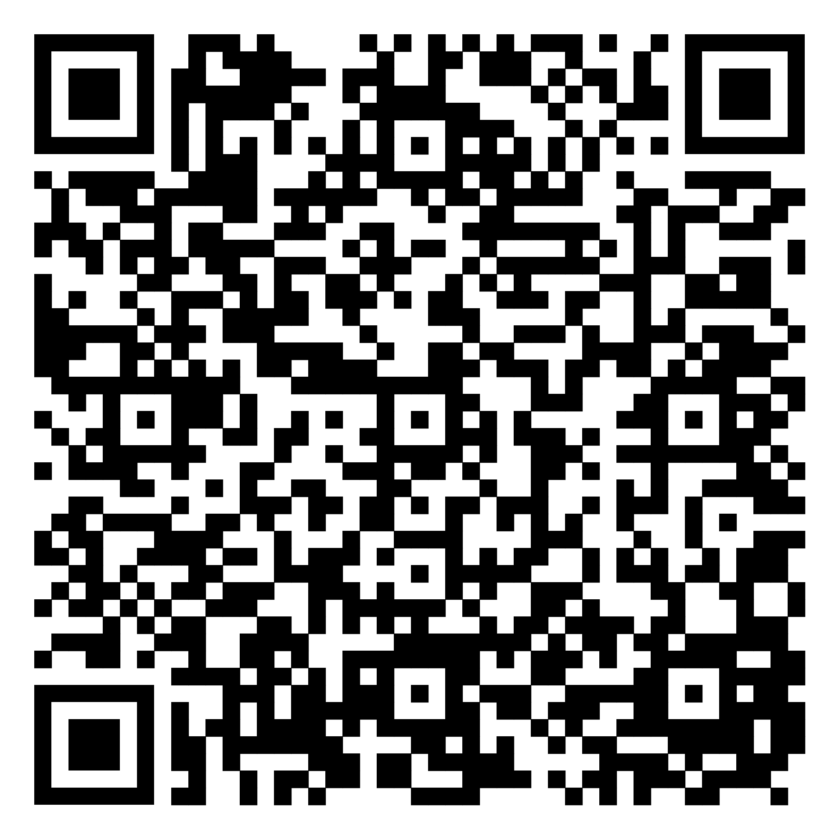
Use case: How is MIT Leveraging an AI Native Architecture?
9,000 AP43 Access Points
Installation in 3 Months
Mist Edge

Slide 15
Real Results
7,000 students and 27,000 devices, all managed by limited IT personnel.
2,000 access points installed in the dorms in less than 48 hours.
Help desk now staffed by grad students.

Slide 16
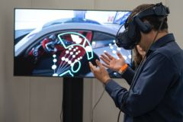
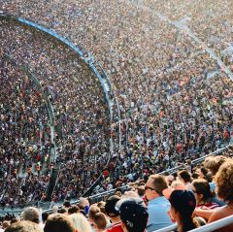
Juniper is the industry’s only
AI-Native Networking Platform
Muito obrigado
Notes:
Every connection matters to us: it shows up in how we serve every one of our customers, in how we obsess over quality and in how we deliver an exceptional experience—every time.
At Juniper Networks we are on a mission: We make every connection count.

