Slide 1
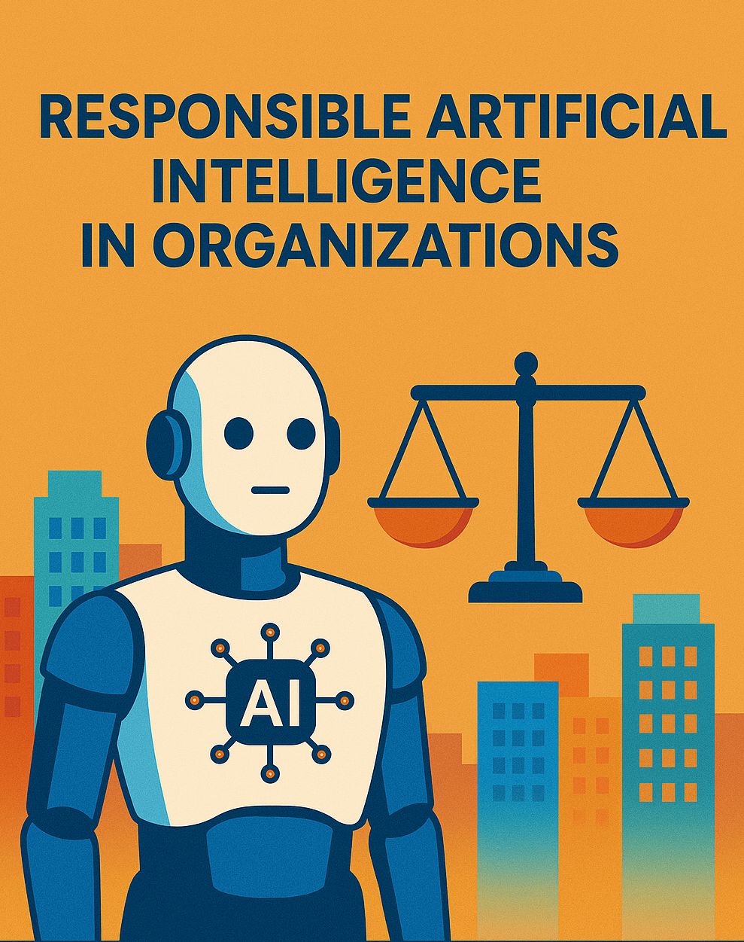
Jornadas FCCN – 2025 Pedro Gomes

Slide 2
Netskope Zero Trust Engine Make continuous, adaptive trust-based policy decisions in real-time
Slide 7
ALLOW
BLOCK
IDENTITY TRUST
DEVICE TRUST
LOCATION TRUST
APP
TRUST
INSTANCE TRUST
ACTIVITY TRUST
BEHAVIOR TRUST
DATA TRUST
COACH
REAUTH
JUSTIFY
ISOLATE
John from Finance
On a Managed Device
Home Office
OneDrive
Personal Instance
Upload
Risky Behavior Score
Company Data Confidential
Block Upload and Coach User
Differentiate between thousands of SaaS instances
Unique Data Protection + DLP approach
Real-time user coaching
60%
95%
of traffic is SaaS and cloud, delivering 50% of threats
of traffic is encrypted—where threats and data hide

Slide 3
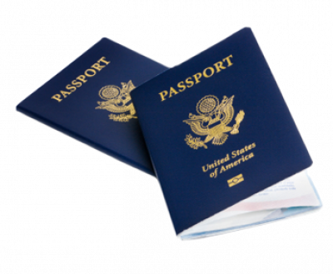
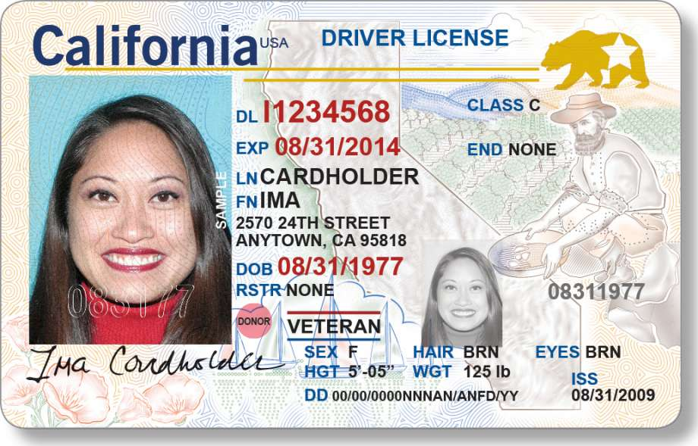
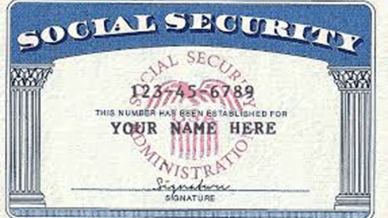
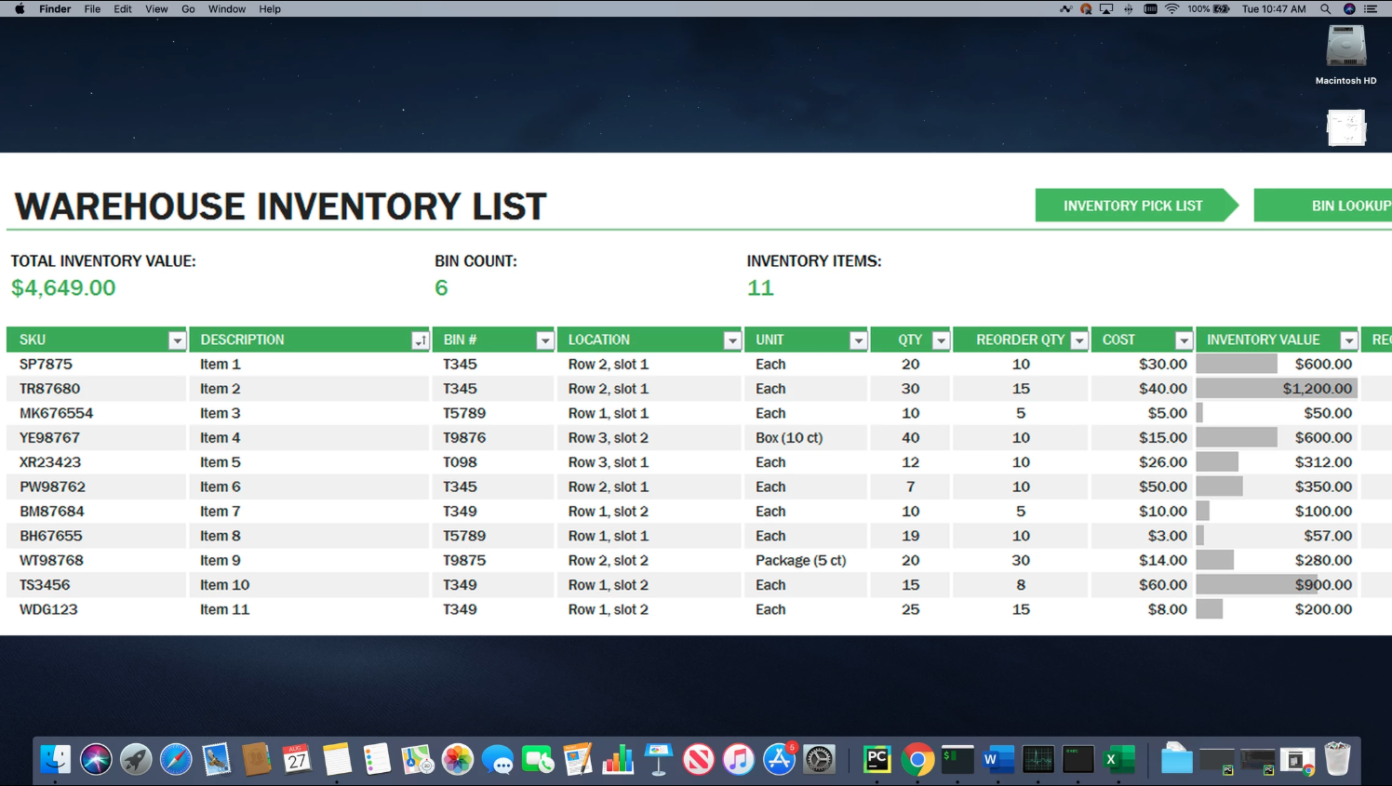
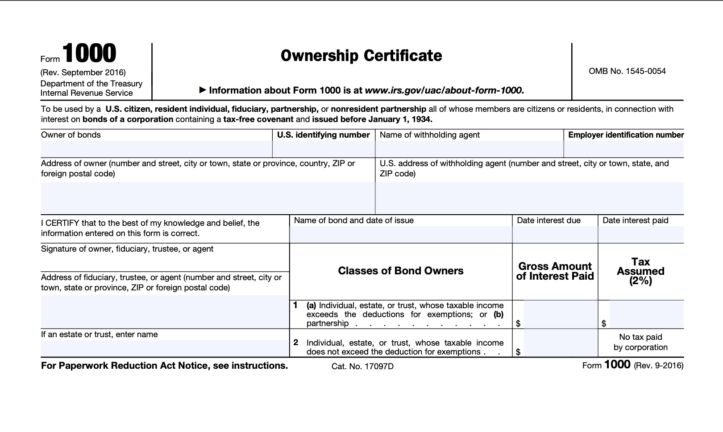
Advanced Cloud Data Protection
5-in-1 DLP (SaaS, IaaS, web, email, endpoint) using a single-pass, SASE-ready architecture
Outbound email (SMTP)
Data to USB Storage device
Netskope Security Cloud
DLP Cloud
Managed & unmanaged clouds (SaaS & IaaS)
Endpoint device
3,000+ data identifiers, 1,500+ file types
Contextual Policies
40+ Compliance Templates
Forward Proxy
Websites
Managed device
Data-in-Motion
ML-enhanced Classification
Exact Match, Fingerprinting, OCR
Single-Pass DLP
Managed clouds (SaaS & IaaS)
Unmanaged device
Reverse Proxy
Data-in-Motion
API Integration
Data-at-Rest
Contextual Policies
ML-enhanced Classification
Exact Match & Fingerprinting
Single-Pass DLP
Apply context to improve efficacy
Find sensitive data others miss
Zero in on inspection target
Enable efficiency
Location
App
IaaS - data-at- rest
IaaS - data-in- motion
Device
Activity
source content
generate hash
perform match
SaaS - data-in- motion
Web
User
Policy
Content
SaaS - data-at- rest
DLP
Email
25+ identifiers and growing
Notes:
Data protection can be for data-in-motion (left side) with forward or reverse proxy inline deployments, or for data-at-rest (right side) for managed cloud apps.

Slide 4
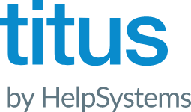
Best-in-class DLP
FingerPrinting
Exact Match
OCR
DLP Fingerprints enable you to protect unstructured confidential information by generating a unique DNA (classification) for sensitive files. Like Fingerprinting, Exact Data Match allows policy to follow structured data. You can feed the system a document or db and it will be able to detect it, even fragments and variations of it. DLP training no longer requires a specialist. OCR works by examining images, either on their own (png, jpeg, gif, bmp) or embedded inside a document (PDF, Office, Archives) thru API Protection
Machine Learning
AI/ML classification for patent and M&A documents(15), tax forms, source code, plus images(12) including desktop screenshots, passports, IDs, etc. (27+ ML classifiers and growing). Includes Train Your Own classifier, the ability to train the AI engine yourself.
Contextual Policies
Device Classification allows you to define rules that function like posture checks, and then evaluate devices based on these rules. The rules vary based on the OS Platform being applied to. Once evaluated, the devices are classified as “Managed” or “ Unmanaged “ Allow granular control of activities
Precision & Accuracy
Data Identifiers
Includes 3,000+ data identifiers available in various languages. Smart data detection based on specific content with high accuracy (NIE, TIE, DNI, Credit Cards, many many more)
Microsoft
Information
Protection
Classification Labels
Fully integrated to read and apply labelling based on metadata and content scans
File Types
Over 1500 file types detected based on true file type to identify all file types and prevent obfuscation to avoid detection
Regular Expressions
& Patterns
Regular Expressions support to provide a wide, deep and accurate detection of sensitive content
Keywords / Phrases
Dictionaries
40+ regulatory compliance templates including GDPR, PII, PCI, PHI, source code, etc.
Includes 3,000+ data identifiers for 1,500+ file types, plus custom regex, patterns, and dictionaries

Slide 5
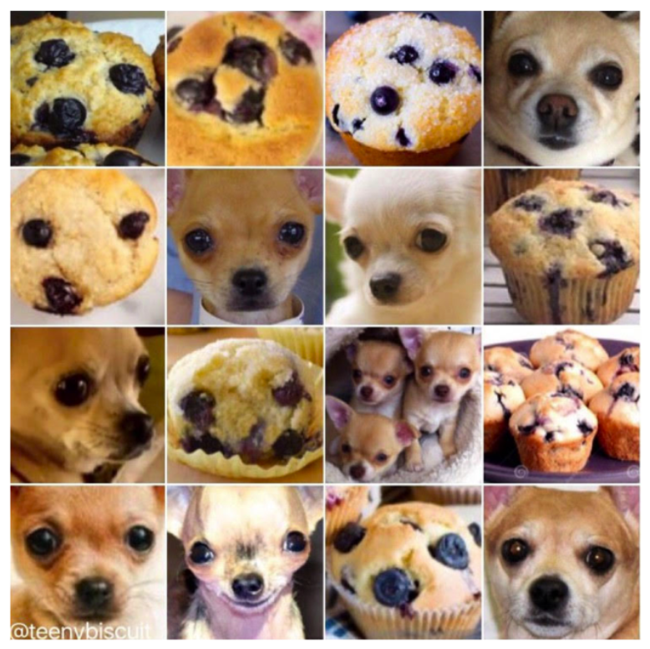
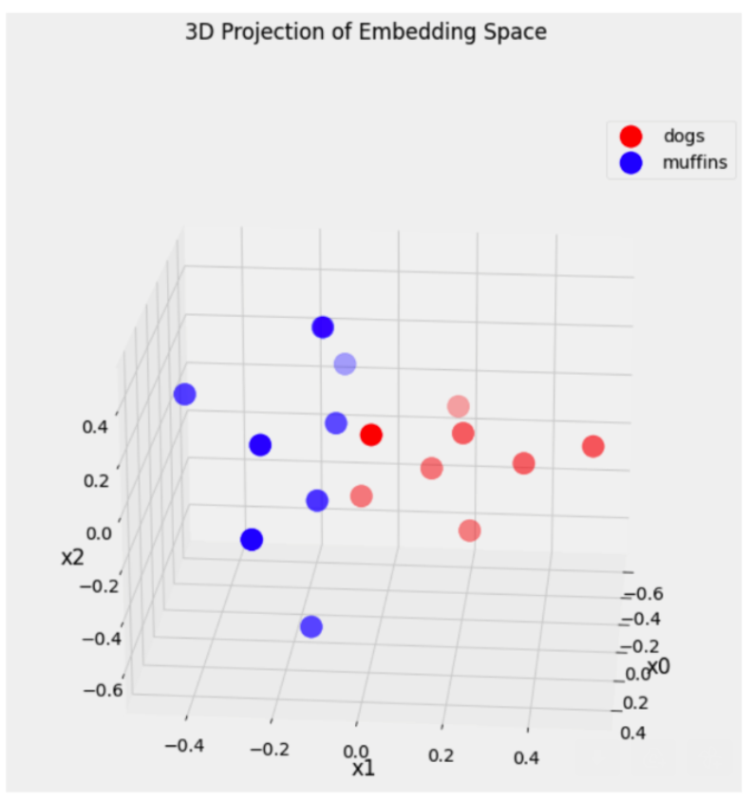
AI Based DLP– Train your own Classifier (Patent Number 11,983,955)

Slide 6
Demo

Slide 7
Obrigado
Pedro Gomes

